Slide 1
Financial risk management: where to next?
MEFMI Retreat for
Heads of Reserve Management
Johan du Plessis
22 September 2017

Slide 2
Agenda
  Global foreign exchange reserves
  Implications of unconventional central bank policies
  Evolution of central bank mandates
  A brief history of Multi Asset
  Modern Multi Asset Funds
  Exposure through private equity
  ETFs
  IAM reserve management philosophy

Slide 3
Global foreign exchange reserves
Global foreign exchange reserves
Percentage of World foreign exchange reserves
Source: Bloomberg

Slide 4
Composition of foreign exchange reserves
World Currency Composition of Official Foreign Exchange Reserves
Share of allocated foreign exchange reserves
Source: IMF COFER Q1 2017

Slide 5
Implication of unconventional Central bank policies
Central Bank balance sheet evolution
G4 2 year yields
Source: Investec Asset Management, Bloomberg

Slide 6
Implication of Central bank policies
  Traditional central bank assets offer low yields
    Cost of insurance has gone up
  Especially in short end of yield curves
  Low coupons and probability of higher yields could lead to negative government bond returns
  In line with other investors; CBs have been forced out on the yield curve and into higher yielding asset classes.
  Adjustment in risk/return appetite
Bloomberg Barclays Global Agg Neg Yielding Debt Market Value USD
Source: Investec Asset Management, using Bank of America ML index data from Bloomberg

Slide 7
Historic returns – selected USD assets
Cumulative % return
Source: Investec Asset Management, using Bank of America ML index data from Bloomberg to 31 July 2017

Slide 8
Historic returns – selected USD assets
Remember….
  The expected return increases but…
  …the range of possible outcomes becomes wider
  Both downside and upside possibilities increase
  There is a greater chance of investment returns deviating from expectations
Source: Investec Asset Management, using Bank of America ML index data from Bloomberg

Slide 9
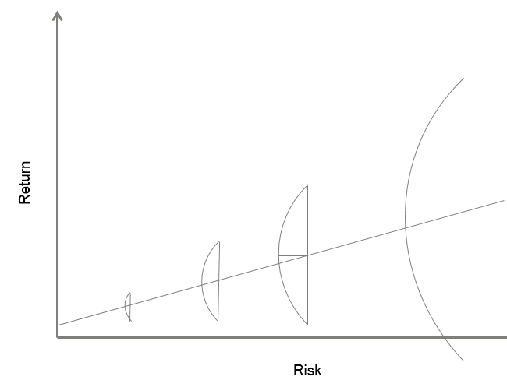
Evolution of central bank mandates
  Enhance yields
    Increase credit risk, duration, new asset classes
  Longer dated benchmarks
  Increased focus on credit risk
  Emerging market debt - China
  Absolute return/ TE limit
  Multi currency benchmarks

Slide 10
Points to ponder
  Is the juice worth the squeeze
  Are we buying at the peak – betting on winners
  Mean reversion
  Volatility Paradox and VAR
Annualised 90 day volatility
Bond yields
Source: Investec Asset Management, using Bank of America ML index data from Bloomberg

Slide 11
Points of interest on emerging market debt
  Interest in asset class has grown tremendously
  Several central bank have already allocated to the asset class
  Need to differentiate between local currency yields and hedged yields
Total AUM Benchmarked against JPM EM indices US$ millions
Source: Investec Asset Management, Bloomberg and JP Morgan

Slide 12
A brief history of Multi Asset
1993
Traditional Balanced
Peer group benchmarks and home bias
2000
Specialised mandates
Opportunity set expanded: used capitalisation-weighted benchmarks
2003
Hedge funds
New multi asset investment techniques: derivatives, relative value, shorting
2006
Diversified Growth Funds
From benchmark to outcome-focused: total return and absolute return
2009
The bond conundrum
Approaches to managing fixed income re-examined
2016
Modern Diversified Growth Funds
Greater sophistication. Risk-based construction. “New” diversification

Slide 13
Modern Multi Asset Funds
Relative value
  Relative Value (RV) investing seeks to exploit differences between related markets or instruments
  Technique reduces the reliance on the direction of markets to generate returns
Europe vs. US Equities: Up markets
Europe vs. US Equities: Down markets
Note: These are indicative examples
Notes:
We are now hitting structural problems as many of these questions have reached a more advanced stage in their development due to rapid growth. This includes political challenges, environmental issues, and impact of DM monetary policy. These challenges are deep and must be understood for both their causes and potential impacts.

Slide 14
Modern Multi Asset Funds
Financial alchemy… of sorts
  Application of these investment techniques can change the characteristics of assets
  For example, let’s consider an Australian Government Bond
Government Bond
    Long
Defensive
Government Bond
    Short
Growth
Government Bond
    Relative Value (vs Gilts)
Uncorrelated
For illustratively purpose only.
Notes:
We are now hitting structural problems as many of these questions have reached a more advanced stage in their development due to rapid growth. This includes political challenges, environmental issues, and impact of DM monetary policy. These challenges are deep and must be understood for both their causes and potential impacts.

Slide 15
Exposure through private equity
  Private equity is an equity investment into non-quoted companies
  Improve company to profit from resale
  No regular market price- use net asset value techniques
  Risk management is different to public equity
  Standard risk models not applicable
    VAR, volatility, etc.
  Long holding periods – illiquid
  10 years with no redemption rights
  Large discount in secondary market
  Large upside potential
  Due diligence is extremely important
Liquidity risk | Funding risk
Market risk | Capital risk
Source: British Private equity and Venture Capital Association

Slide 16
ETFs
  Liquid access to the financial markets
  Investor has a proportional interest in the pooled assets.
  ETF offer intraday liquidity
  As ETFs and ETCs are passive investments mirroring a market or index
  You are the owner of the beta
  No downside protection
  Do the investors know what they are getting themselves into?
  Have they done their due diligence?
  Just Because You Can, Doesn’t Mean You Should (Jared Dillian, Mauldin economics)
Global ETF and ETP Assets (US$ Billion)
Types of ETFs
United States Market Index
Foreign Market Index
Foreign Currency
Sector and Industry
Commodity
Derivative
Style
Types of ETFs
Bond
ETN
Inverse
Leveraged
Actively Managed
Dividend
Innovative
Source: ETFGI.COM

Slide 17
IAM reserve management philosophy
Investment approach | Our rationale | Our belief
Credit risk averse | The private sector cannot produce risk-free assets | Capital stability is sacrosanct
Invest in plain vanilla instruments | Market liquidity is variable and cannot be guaranteed. | Liquidity is confidence
Add value through active interest rate management | The market is poor at forecasting bond markets | Bold interest rate management

Slide 18
Thank you
www.investecassetmanagement.com

Slide 19
Important information
GENERIC INSTITUTIONAL DISCLAIMER
All information and opinions provided are of a general nature and are not intended to address the circumstances of any particular individual or entity. We are not acting and do not purport to act in any way as an advisor or in a fiduciary capacity. No one should act upon such information or opinion without appropriate professional advice after a thorough examination of a particular situation. We endeavour to provide accurate and timely information but we make no representation or warranty, express or implied, with respect to the correctness, accuracy or completeness of the information and opinions. We do not undertake to update, modify or amend the information on a frequent basis or to advise any person if such information subsequently becomes inaccurate. Any representation or opinion is provided for information purposes only.
In In the event that specific funds are mentioned please refer to the relevant fact sheet in order to obtain all the necessary information in regard to that fund.
Collective Investment scheme funds are generally medium to long term investments. The value of participatory interests may go down as well as up and past performance is not necessarily a guide to the future. Funds are traded at ruling prices and can engage in borrowing and scrip lending. A schedule of charges, fees and adviser fees is available on request from the manager. Additional adviser fees may be paid and if so, are subject to the relevant FAIS disclosure requirements.
Investment Team: There is no assurance that the persons referenced herein will continue to be involved with investing for this Fund, or that other persons not identified herein will become involved with investing assets for the Manager or assets of the Fund at any time without notice.
Investment Process: Any description or information regarding investment process or strategies is provided for illustrative purposes only, may not be fully indicative of any present or future investments and may be changed at the discretion of the manager without notice. References to specific investments, strategies or investment vehicles are for illustrative purposes only and should not be relied upon as a recommendation to purchase or sell such investments or to engage in any particular strategy. Portfolio data is expected to change and there is no assurance that the actual portfolio will remain as described herein. There is no assurance that the investments presented will be available in the future at the levels presented, with the same characteristics or be available at all. Past performance is no guarantee of future results and has no bearing upon the ability of Manager to construct the illustrative portfolio and implement its investment strategy or investment objective.
Certain Investec Asset Management funds are offered as long-term insurance policies issued by Investec Assurance Limited, a registered insurer in terms of the Long-term Insurance Act.
This presentation is the copyright of Investec and its contents may not be re-used without Investec’s prior permission.
Investec Asset Management is an authorised financial services provider.

