Slide 1
Current global financial risk characteristics
MEFMI Retreat for
Heads of Reserve Management
Johan du Plessis
20 September 2017

Slide 2
Agenda
  Setting the scene
  Investment risk assessment
  Operational risk assessment
  Conclusion

Slide 3
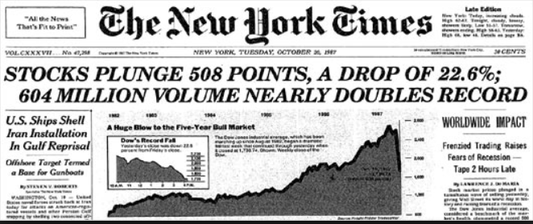
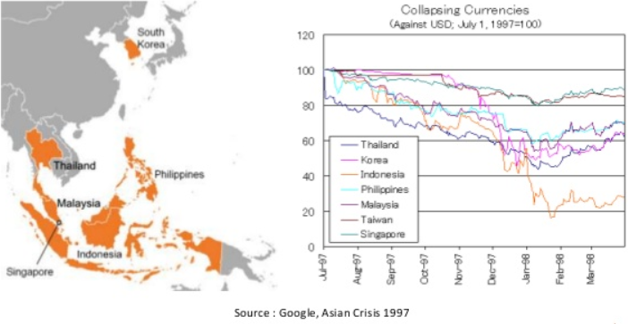
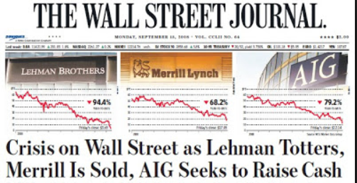
A timeline of market disasters
Setting the scene
  30 years ago
    Black Monday refers October 19, 1987
  20 years ago
    Asian financial crisis
  10 years ago
    Global financial crisis

Slide 4
Current global financial risk characteristics
Setting the scene
  The effects of the Global Financial Crisis are fading
  Global growth is picking up
  And inflation is firming
  Financial markets have performed well
  And commodity prices are, on balance, recovering too
  But much of this stability has been engineered by the extraordinary measures taken by policy makers
  And investors have undertaken a monumental ‘search for yield’
  However, some of central bank policies are now being unwound
  Will the peace hold?
  And are we equipped with the correct tools to handle possible dislocations?
Global GDP & CPI
MSCI AWD Index
Commodity Prices
Sources: IMF WEO database April 2017, Bloomberg & Investec Asset Management calculations

Slide 5
Current global financial risk characteristics
Investment Risk Assessment – Credit
  The Global Financial Crisis saw credit conditions deteriorate across the world
  The credit rating agencies were behind the curve, still upgrading more Investment Grade ratings than downgrading in 2007
  In recent years, ratings are rising again as balance sheets are repaired
  There is no doubt banks are better capitalised and credit standards have been tightened
  But corporate borrowers are now much more leveraged, taking advantage of low interest rates to borrow heavily
  Much of this has gone into share buyback, fuelling markets
US IG credit rating changes
Western Europe IG credit rating changes
Asia Pacific IG credit rating changes
Sources: Bloomberg & Investec Asset Management calculations

Slide 6
Current global financial risk characteristics
Investment Risk Assessment – Credit
  The deleveraging post GFC looks very modest now
  US corporate leverage ratios are elevated relative to history and close to record highs.
  Previous periods of elevated leverage ratios, in the early 2000s and 2009, have been a result of earnings impairment – ex energy this has not yet occurred.
  Corporate leverage ratios are therefore at their healthy economy highs.
  With the US Federal Reserve raising interest rates and reducing their balance sheet, this is a clear vulnerability
Total Credit to Corporations in Japan and the US
Investment Grade Debt to EBITDA Ratios
Sources: Federal Reserve Bank of St Louis & Investec Asset Management calculations

Slide 7
Current global financial risk characteristics
Investment Risk Assessment – Credit
  Despite the releveraging experienced…
  … credit spreads are back to pre-crisis levels
  As investors have chased anything with a yield
  This has been aided by European Central Bank buying of corporate debt
  From here, it is not clear that credit pays for the risk being taken
  Investor Bail In regulation adds a further complication
Sources: Bloomberg & Investec Asset Management calculations

Slide 8
Current global financial risk characteristics
Investment Risk Assessment – Liquidity
  ‘as a result of the elusive nature of the concept, it is unlikely that a single measure can capture all relevant aspects of global liquidity’ BIS, Global Financial System Papers No. 45, Nov-11
  ‘Liquidity is confidence’ Kevin Warsh, 2007
  Think about liquidity as both demand and supply
  We, as investors, demand liquidity when we transact in financial markets
  A typical Reserve Manager index has seen its face value increase 130% since 2007 – demand has increased
  It is supplied by market makers, usually major banks and specialist intermediaries
  Tighter capital requirements and stronger regulation has reduced supply
Sources: Bank of America Merrill Lynch, Bloomberg & Investec Asset Management calculations

Slide 9
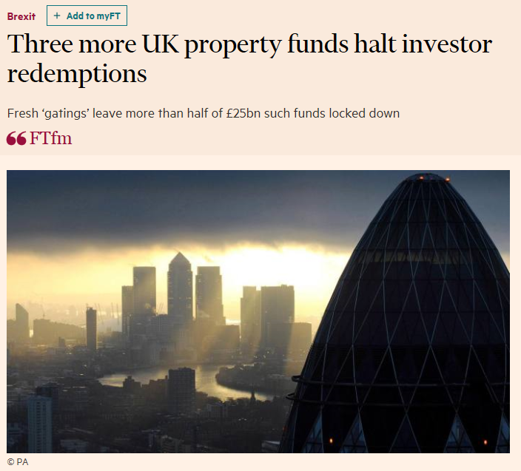
Current global financial risk characteristics
Investment Risk Assessment – Liquidity
  Beware the illusion of liquidity…
  No bank can fund all client cash demands at the same time
  Mutual funds offer same day liquidity in illiquid assets – UK property funds over the Brexit vote
  Exchange Traded Funds offer intraday liquidity
Sources: Financial Times, Bloomberg & Investec Asset Management calculations

Slide 10
Current global financial risk characteristics
Investment Risk Assessment – Foreign Exchange
  Once interest rates in advanced economies hit the zero lower bound currency became very sensitive to minor changes in policy
  This lesson was forgotten as investors rushed to emerging market debt
  But the effect of a higher USD, as the FOMC raised Fed Funds modestly, swamped any yield pick up
  With interest rates still close to the ZLB we expect FX to remain a major influence on asset pricing
  Do Reserve Managers overlook this as a source of possible alpha?
Sources: Bloomberg & Investec Asset Management calculations

Slide 11
Current global financial risk characteristics
Investment Risk Assessment – Interest Rate
  Potentially the greatest danger of all
  Yields are at historic lows
  And debt is at historic highs
  The market’s sensitivity to higher interest rates as therefore never been higher
  But just how high do we think interest rates in advanced economies can rise?
  And medium term interest in the medium term are already in line with the Federal Reserve’s assessment of neutral
  And there is an argument that the 1970 to 2008 period was the exception…
Selected 10 year government bond yields
10 year nominal government bond yields – rolling 3 year average
Sources: Homer: a history of interest rates, Bloomberg & Investec Asset Management calculations

Slide 12
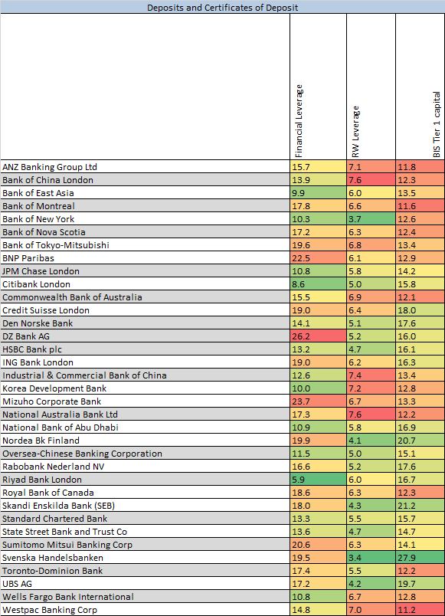
Current global financial risk characteristics
Operational Risk Assessment – Counterparty
  Banks are far better capitalised
  And have much lower leverage
  As such, their status as counterparties is stronger
  The push toward centralised clearing helps too
  As do ‘living wills’
  Not clear if counterparties are still ‘too connected too fail’ as the system has not been tested
Sources: IMF WEO database April 2017, Bloomberg & Investec Asset Management calculations

Slide 13
Current global financial risk characteristics
Operational Risk Assessment – Cyber
  ‘The only truly secure system is one that is powered off, cast in a block of concrete and sealed in a lead-lined room with armed guards"
  In February 2016 the Central bank of Bangladesh saw $81m misappropriated
  Defined by the Bundesbank as ‘a deliberately targeted and IT-based attack on data and IT systems which can viably impair confidentiality, integrity, or availability’
  ‘Well-known hacker Kevin Mitnick - who allegedly hacked into the US Department of Defence's network more than one hundred times and penetrated NSA systems on multiple occasions - once said:’ "Companies spend millions of dollars on firewalls, encryption, and secure access devices and it's money wasted because none of these measures address the weakest link in the security chain: the people who use, administer, operate and account for computer systems that contain protected information."
Sources: Joachim Wuermeling: Cybersecurity - pivotal for central banks, Keynote speech by Prof Joachim Wuermeling, Member of the Executive Board of the Deutsche Bundesbank, at the 2nd Payments Drift Forum, Euroforum, Aschaffenburg, 7 September 2017.

Slide 14
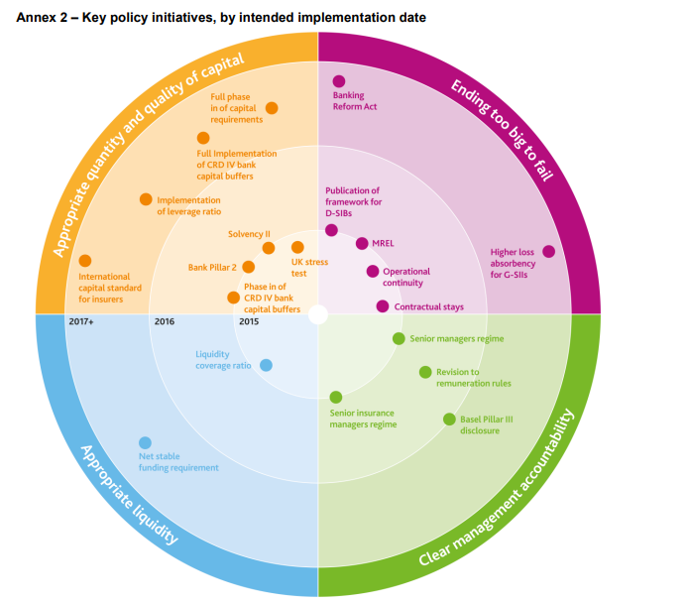
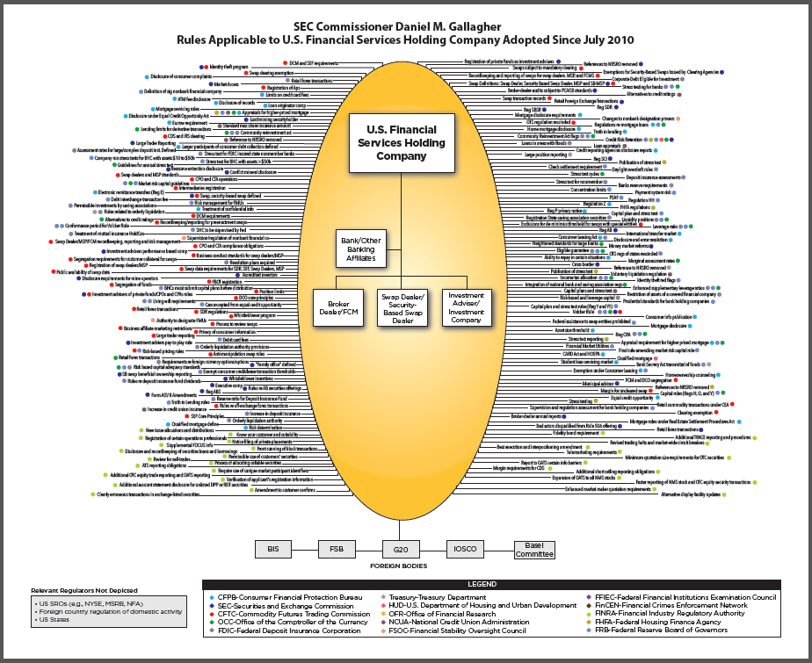
Current global financial risk characteristics
Operational Risk Assessment – Regulatory
Sources: UK PRA Annual Report 2014/15 & Crazy Quilt Chart of Regulation, SEC Commissioner Daniel M. Gallagher, 3 June 2015

Slide 15
Current global financial risk characteristics
Operational Risk Assessment – Regulatory
  There is no doubt that pre-crisis regulation was too lax
  But have we gone too far?
  US Administration already pushing back
  And the burden of implementing so much regulation is burdensome
  And are there unintended consequences
  Focus shifting from banks to asset managers and investment consultants
  But bottom line has to be a safe financial sector that protects taxpayers and ends too big to fail

Slide 16
Current global financial risk characteristics
Conclusion
  Optically strong but structurally weak?
  Is low volatility the time of maximum danger?
  What are the unintended consequences of super easy policy and much tighter regulation?
  Risk can be quantified but markets are uncertain
  Better to be roughly right than precisely wrong

Slide 17
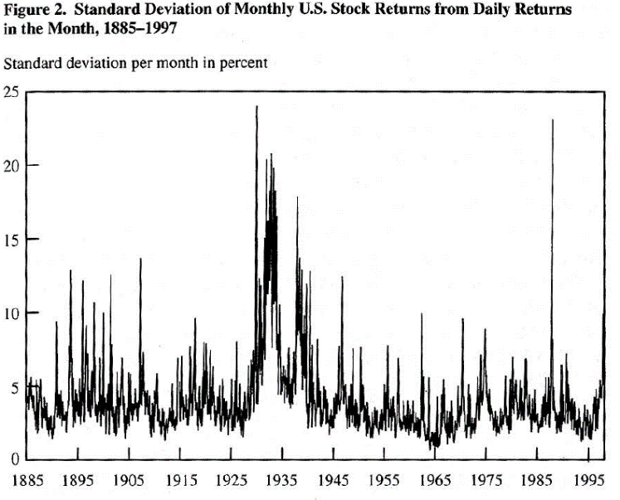
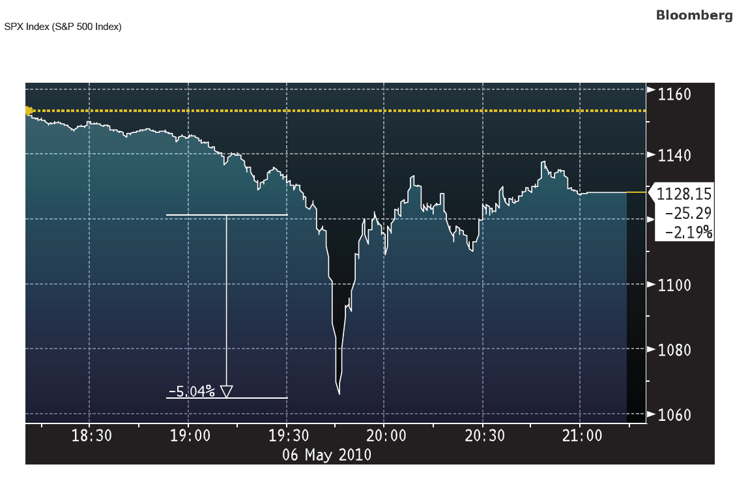
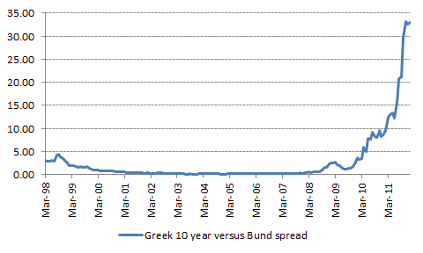
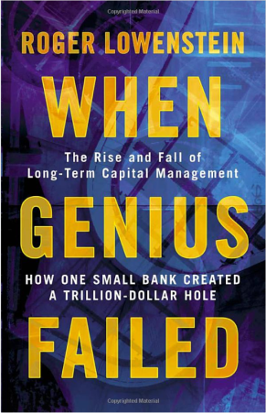

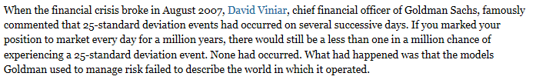
A scrapbook of financial mishaps
On Monday 19th October 1987 the Dow Jones Industrial Average fell 22.61%
Source: Stock market volatility: 10 years after the Crash, G. William Schwert, Study commissioned for the 1997 Brookings-Wharton conference on Financial Institutions
At 19.30 on 6 May 2010 the S&P index fell 5% in 3 minutes and bounced straight back. To this day, nobody really knows what happened
Source: Bloomberg
In January 2005 Greek 10 year bonds yielded just 9 basis points more than German Bunds
Source: Bloomberg & IAM calculations
Source: Financial Times 13 Aug 2007
LTCM calculated that a 45% drop in its equity value over the course of a month was a 10 standard deviation event.
Source: Long Term Capital Management,: The Dangers of Leverage, Siddharth Prabhu, Duke University, May 2001
Source: Johnkay.com 03 Mar 2011, accessed 27 Aug 2015

Slide 18
Thank you
www.investecassetmanagement.com

Slide 19
Important information
GENERIC INSTITUTIONAL DISCLAIMER
All information and opinions provided are of a general nature and are not intended to address the circumstances of any particular individual or entity. We are not acting and do not purport to act in any way as an advisor or in a fiduciary capacity. No one should act upon such information or opinion without appropriate professional advice after a thorough examination of a particular situation. We endeavour to provide accurate and timely information but we make no representation or warranty, express or implied, with respect to the correctness, accuracy or completeness of the information and opinions. We do not undertake to update, modify or amend the information on a frequent basis or to advise any person if such information subsequently becomes inaccurate. Any representation or opinion is provided for information purposes only.
In In the event that specific funds are mentioned please refer to the relevant fact sheet in order to obtain all the necessary information in regard to that fund.
Collective Investment scheme funds are generally medium to long term investments. The value of participatory interests may go down as well as up and past performance is not necessarily a guide to the future. Funds are traded at ruling prices and can engage in borrowing and scrip lending. A schedule of charges, fees and adviser fees is available on request from the manager. Additional adviser fees may be paid and if so, are subject to the relevant FAIS disclosure requirements.
Investment Team: There is no assurance that the persons referenced herein will continue to be involved with investing for this Fund, or that other persons not identified herein will become involved with investing assets for the Manager or assets of the Fund at any time without notice.
Investment Process: Any description or information regarding investment process or strategies is provided for illustrative purposes only, may not be fully indicative of any present or future investments and may be changed at the discretion of the manager without notice. References to specific investments, strategies or investment vehicles are for illustrative purposes only and should not be relied upon as a recommendation to purchase or sell such investments or to engage in any particular strategy. Portfolio data is expected to change and there is no assurance that the actual portfolio will remain as described herein. There is no assurance that the investments presented will be available in the future at the levels presented, with the same characteristics or be available at all. Past performance is no guarantee of future results and has no bearing upon the ability of Manager to construct the illustrative portfolio and implement its investment strategy or investment objective.
Certain Investec Asset Management funds are offered as long-term insurance policies issued by Investec Assurance Limited, a registered insurer in terms of the Long-term Insurance Act.
This presentation is the copyright of Investec and its contents may not be re-used without Investec’s prior permission.
Investec Asset Management is an authorised financial services provider.

