Slide 1
The Strategic Asset Allocation key risk considerations
MEFMI Retreat for
Heads of Reserve Management
Johan du Plessis
20 September 2017

Slide 2
Agenda
  Strategic asset allocation
  Risk versus uncertainty
  Volatility paradox
  Traditional versus alternative asset classes
  An alternative approach to risk: GDU

Slide 3
Strategic asset allocation
  Appropriate asset allocation to achieve long-term investment objectives
      Asset allocation is the primary determinant of a portfolio’s return variability
    Long term objectives are influenced by the adequacy of reserves
      Capital preservation, liquidity, return, etc.
  Each tranche of reserves will have different objectives
      Liquidity, buffer, investment
      Sovereign wealth fund
Percentage of variation explained
(1977-1987)
Source:1986, Gary P. Brinson, CFA, Randolph Hood, and Gilbert L. Beebower, “Determinants of Portfolio Performance,” published in the Financial Analysts Journal

Slide 4
Categorising Sovereign Investors
Category | Reserves Managers | Supranational Agencies | Future Generation Funds | National Investments Funds | State Holding Companies
Explicit Liability | Meet shortfall in government revenues due to volatile FX or commodities prices | Emergency funds, Development funds | Often not specific, in some cases, future pension fund liabilities | No specific liability | No specific liability
Investment Objective | Capital preservation, liquidity, currency peg | Capital Preservation, liquidity | Inter-generational wealth sharing | Maximising return, intergenerational sharing, domestic economic objectives | Inter-generational wealth sharing, maximising return, domestic and foreign strategic objectives
Risk Tolerance | Low | Low – Medium | Medium – High | Medium – High | High
Investment Horizon | 0 – 3 years | 3 – 10 years | 10 years – perpetual | 10 years – perpetual | 10 years – perpetual
Example | Central bank reserves managers | IMF, World Bank, BIS, EFSF | ADIA, Norges Bank, Australia, China NSSF, national and local authority pension schemes, GIC | ADIA, Korea Investment Corporation, China CIC, GIC | Temasek, China CIC
Source: Investec Asset Management and UBS

Slide 5
The chart we are all familiar with
  ‘Riskier investments produce higher returns’
  ‘Take more risk if you want higher returns’
  If riskier investments could be counted on to produce higher returns, they wouldn’t, by definition, be riskier!
Return
Risk
Source: Based on Oaktree Capital Management L.P., Howard Marks, Risk Revisited Again

Slide 6
A different interpretation
  The expected return increases but…
  … the range of possible outcomes becomes wider
  Both downside and upside possibilities increase
  There is a greater chance of investment returns deviating from expectations
Return
Risk
Source: Based on Oaktree Capital Management L.P., Howard Marks, Risk Revisited Again

Slide 7
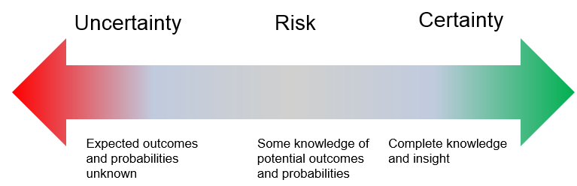
Risk versus uncertainty
  Risk
    Future events occur with known probability
  Uncertainty
    Event likelihood is undefined or unknowable
  If markets are uncertain, we are unable to make distributional assumptions
  Adopt proxy guides; better to be roughly right than precisely wrong
  Use history as our guide to attempt awareness of all possible scenarios
  Value at Risk can be useful with an appropriate data sample but be cynical
  Stress testing; prepare for the future & understand consequences

Slide 8

Statement of belief
  We believe markets are uncertain rather than risky
    Why?
    Risk measures a range of known possible outcomes
    Financial history has taught us that not all outcomes are knowable in advance.
    By definition, therefore, they are uncertain
  Why might financial markets be uncertain?
    Assigning probabilities to high impact but rare events is difficult
    Financial systems can be sensitive to small changes in conditions as they are so interconnected
    Markets involve human participants and their actions shape economic outcomes
“Markets are not risky; they are uncertain”

Slide 9
The Volatility Paradox
  Financial market volatility is extremely low.
  Low volatility could cause financial instability
    Increased leverage
    Reduced hedging
    Risk-management models
  Financial market volatility is extremely low.
S&P 500 Index: 90 day realised volatility
Source: Office of financial research, A review of financial market themes and developments, Second quarter 2017

Slide 10
The Volatility Paradox
  Two types of volatility: realized and implied
    Realized is what actual happened
    Implied is what we think will happen
  Market risks may seem low when volatility is low
    A low VIX doesn’t necessarily signal that severe financial stress is unlikely.
Volatility paradox
  low volatility may be a catalyst to take more risk
  Asset-return correlations tend to increase when markets are volatile
    Prolonged periods of low volatility may further decrease correlations, encouraging further risk-taking
S&P 500 Index: Implied vs realised volatility
Source: Office of financial research, A review of financial market themes and developments, Second quarter 2017

Slide 11
The Volatility Paradox
  Value-at-Risk models may give faulty signals in low-volatility markets
    Backward looking approach that captures how much value investments might lose over a set time.
  VAR could result in pro-cyclical behaviour
    Vulnerable to volatility shocks
  Low volatility lowers VAR
    Position sizes can increase without breaching limits
  But beware of the unwind
    As volatility rises VAR followers will be forced to sell assets to avoid breaching limits
Cumulative 10 year government bond yield change
Source: Office of financial research, A review of financial market themes and developments, Second quarter 2017

Slide 12
Traditional versus alternative asset classes
  Traditional asset classes
    Include stocks, bonds, and cash
  Alternative asset classes
    Mutual funds, commodities, real estate, private equity, hedge funds
Equities
Credit
FX and Rates
PIPE
Commodities
Alternative Risk Premia
Asset Universe

Slide 13
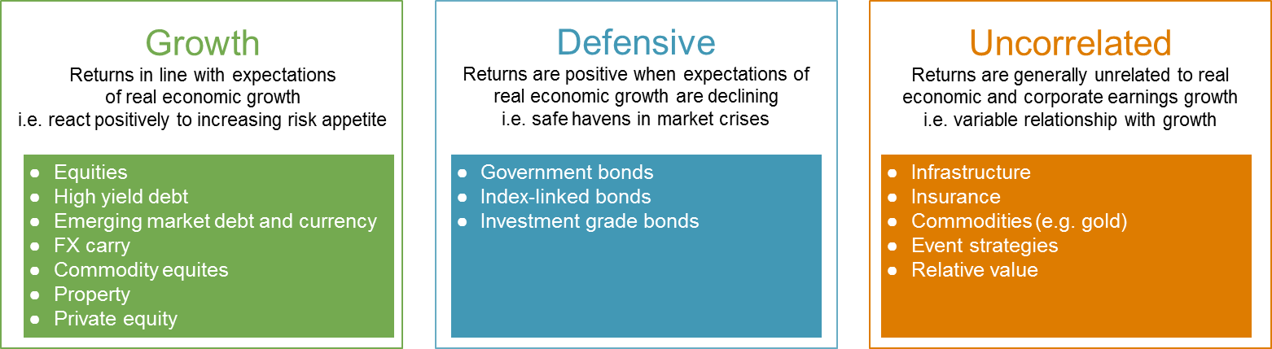
We classify the assets into three broad groups in terms of risk appetite

Slide 14
Behaviours not labels
  All investments exhibit either Growth, Defensive or Uncorrelated characteristics
  If a long position in an asset is labelled as growth then the opposite would be true if you were short that asset i.e. defensive Long G = Short D
Correlation to developed market equity through time
Source: Investec Asset Management and Bloomberg

Slide 15
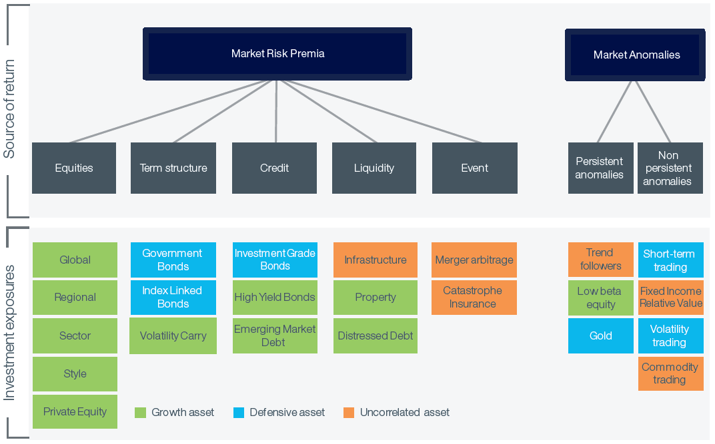
GDU
  Risk premium is the compensation investors require for additional risk
  A major determinant of the level for risk premia is the general risk appetite of the market.
  Since the risk premia have common drivers, the asset classes – which are combinations of the underlying risk premia – will also have common drivers
Richard Grinold The Fundamental Law of Active Management 1989. See Investec Asset Management research paper: Diversified Growth Portfolios: Beyond Naïve Diversification, 2012

Slide 16
Quarterly
Behaviours not labels
  Growth:
    Reacts positively to economic strength
    Positive correlation with equities over time
  Defensive:
    Reacts positively to economic weakness
    Safe havens in market crises
  Uncorrelated:
    Variable relationship with economic growth
    Independent returns to equities
  Expected future behaviours drive our categorisation
Rolling 5 year correlations with Developed Market Equities
Increasingly positive relationship with equities
High yield bonds
Hungarian forint vs. Polish zloty
Increasingly negative relationship with equities
German government bonds
Source: Investec Asset Management, 30 June 2017. The following indices are used: Developed Market Equities = MSCI World Index; US High Yield = The BofA Merrill Lynch US Cash Pay High Yield Index; 10-year German government bonds = IBOXX Euro Germany Sovereign Overall Total Return Index; Hungarian forint vs Polish zloty = HUF/PLN spot exchange rate. For further information on indices, please see the Important information section

Slide 17


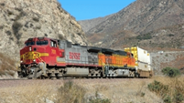












GDU asset in practise
Update circles Monthly
Update rest of slide when advised
Japanese Equity Basket
Long US Equity vs
US Restaurants
Indian Rupee vs
US dollar
US railroads vs
US Equity
30 Year US Treasuries
Germany Govt Bonds vs Italy Govt Bonds
Spain vs
European equity
  Growth
Defensive
  Uncorrelated
UPDATE MONTHLY
Update circles from slide 22 – number of strategies and percentage of risk
Digital Leaders
Equity Basket
US Property
(Amazon distribution)
Canada Govt Bonds
Japanese Yen vs US dollar
Global Infrastructure
Cash vs 2 Year
Czech bonds
High yield
credit basket
.
Source: Investec Asset Management, 31 July 2017. This is not a recommendation to buy, sell or hold a particular security. For further information on specific portfolio names, please see the Important Information section.
Notes:
ESG

Slide 18
Thank you
www.investecassetmanagement.com

Slide 19
Important information
GENERIC INSTITUTIONAL DISCLAIMER
All information and opinions provided are of a general nature and are not intended to address the circumstances of any particular individual or entity. We are not acting and do not purport to act in any way as an advisor or in a fiduciary capacity. No one should act upon such information or opinion without appropriate professional advice after a thorough examination of a particular situation. We endeavour to provide accurate and timely information but we make no representation or warranty, express or implied, with respect to the correctness, accuracy or completeness of the information and opinions. We do not undertake to update, modify or amend the information on a frequent basis or to advise any person if such information subsequently becomes inaccurate. Any representation or opinion is provided for information purposes only.
In In the event that specific funds are mentioned please refer to the relevant fact sheet in order to obtain all the necessary information in regard to that fund.
Collective Investment scheme funds are generally medium to long term investments. The value of participatory interests may go down as well as up and past performance is not necessarily a guide to the future. Funds are traded at ruling prices and can engage in borrowing and scrip lending. A schedule of charges, fees and adviser fees is available on request from the manager. Additional adviser fees may be paid and if so, are subject to the relevant FAIS disclosure requirements.
Investment Team: There is no assurance that the persons referenced herein will continue to be involved with investing for this Fund, or that other persons not identified herein will become involved with investing assets for the Manager or assets of the Fund at any time without notice.
Investment Process: Any description or information regarding investment process or strategies is provided for illustrative purposes only, may not be fully indicative of any present or future investments and may be changed at the discretion of the manager without notice. References to specific investments, strategies or investment vehicles are for illustrative purposes only and should not be relied upon as a recommendation to purchase or sell such investments or to engage in any particular strategy. Portfolio data is expected to change and there is no assurance that the actual portfolio will remain as described herein. There is no assurance that the investments presented will be available in the future at the levels presented, with the same characteristics or be available at all. Past performance is no guarantee of future results and has no bearing upon the ability of Manager to construct the illustrative portfolio and implement its investment strategy or investment objective.
Certain Investec Asset Management funds are offered as long-term insurance policies issued by Investec Assurance Limited, a registered insurer in terms of the Long-term Insurance Act.
This presentation is the copyright of Investec and its contents may not be re-used without Investec’s prior permission.
Investec Asset Management is an authorised financial services provider.

