Slide 1
Market risk
MEFMI Retreat for
Heads of Reserve Management
Johan du Plessis
21 September 2017

Slide 2
Agenda
  The independent risk management framework: a ‘must have’
  Portfolio Manager Risk Framework
  Market based risk
  Behaviour not labels- How we think of risk
  Stress test portfolio for scenarios- event risk
  Other points of interest

Slide 3
The independent risk management framework: a ‘must have’
Investment Risk
Management
Are the portfolio characteristics and investments made consistent with the chosen investment process?
Performance Attribution
Are we attributing the performance, variance, and volatility of an instrument correctly?
Portfolio Monitoring
Are investments compliant with regulation in the jurisdiction we have invested? With our client’s mandate?
Operational Risk Management
Are our selected counterparties still sound and reputable?
Risk & Performance Group
Compliance
Group
Both groups report in to Global Risk Committee

Slide 4
Portfolio Manager Risk Framework
An operationally independent risk team is crucial. However, it should not give false comfort to portfolio managers
Markets crave numerical assurance but the history of financial markets suggest the quantitative certainty of risk models are not compatible with the qualitative world in which participants operate
It is important that the portfolio managers are able to understand, identify, manage and monitor those risks
This should lead to better risk adjusted returns
Identify Risk
Liquidity
Credit
Manage Risk
Needs to go beyond portfolio constraints and risk budget
Understand relationships between markets
On-going monitoring
Regular scoring of chosen metrics
Wide reading to understand changing dynamics
Currency
Interest Rate

Slide 5
On-going monitoring
  Communication is critical
    Regular communication with portfolio managers and within the risk team is essential
    Ensures adherence to underlying investment philosophy: you need highly-disciplined portfolio managers who ultimately assume responsibility
    Risk management is a key facilitator in this process
  Prevention
    Pre-trade administrative checks using main dealing system
    ex-ante (or predictive) risk estimation
  Rigorous ex-post monitoring
    Frequency and type of monitoring depend on capability
    Formal outputs and follow-up

Slide 6
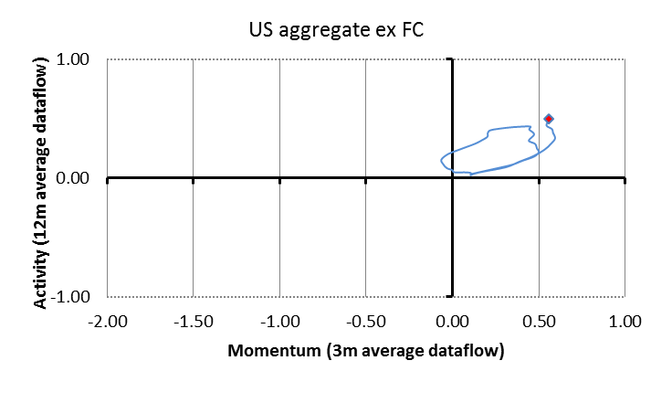
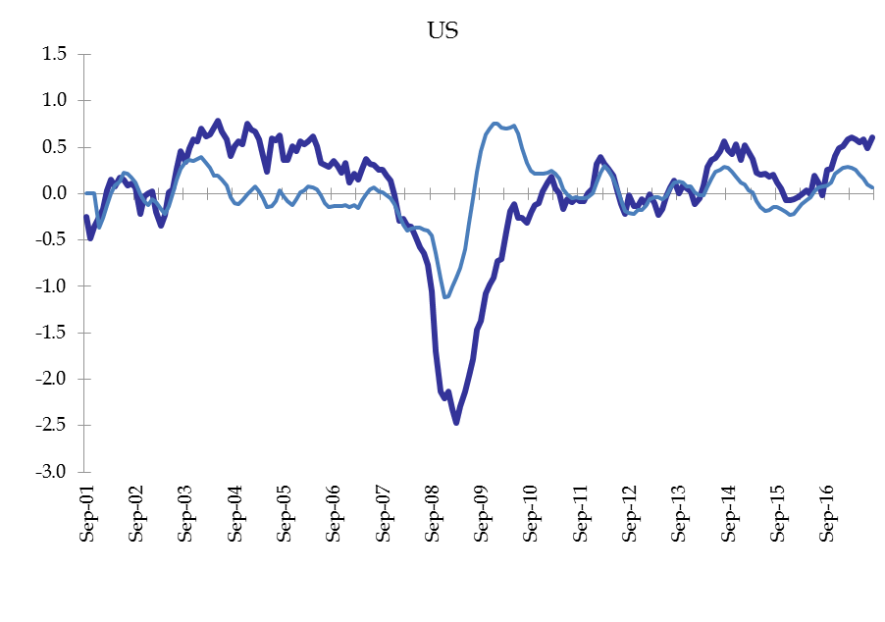
Market based risk: Interest Rate
Definition | IAM philosophy | Investment Implication | Monitoring and Controlling
The risk of adverse mark to market moves due to a sharp move in market interest rates | We believe that superior risk adjusted returns from correct positioning for the prevailing interest rate regime can add value for our clients | Active management of duration, yield curve, cross-country and inflation linked government bonds expressed as ‘Strategic Themes’. A function of the prevailing interest rate regime | Part of our systematic process; set out rational and risks to view. Monitor both and change view if necessary. Read central bank Minutes carefully. Policy openness is now widely practiced.
…systematic process. Our data monitors follow a wide range of publically available economic releases to determine what interest rate regime an economy is in

Slide 7
Market based risk: Liquidity
Definition | IAM philosophy | Investment Implication | Monitoring and Controlling
The risk of not being able to sell an asset or close a position without an effect on costs | Our belief is that ‘Liquidity is Confidence’. It is variable and depends on market conditions. It cannot be guaranteed. | Plain vanilla instruments and clear understanding of where liquidity pools are deepest | We regularly score banks on our lending list to ensure we are able to sell their issuance. This dictates the maximum maturity of the investment; the lower our liquidity assessment, the shorter the maturity. Monitor market volatility. Higher volatility = more uncertainty = less confidence = lower liquidity
Liquidity subjective overlay. Scores rate 1 (Strong yes) to 5 (Strong no)
Question | Liquidity implication
Rare Issuer? | The rarer an issuer the more likely to be room on other institutions’ lending lists. Very regular issuers tend to clog up limits quickly. Therefore, the rarer the issuer, the easier it should be to sell
Trade well? | Some names are regular issuers but still trade well in the secondary market. Stickier names are harder to sell
Buy back own paper? | An issuer may be a frequent issuer and not trade particularly well but still undertake to buy back their own issuance in order to ensure liquidity
…IAM’s subjective liquidity overlay allows us to monitor changing liquidity conditions in the banking sector

Slide 8
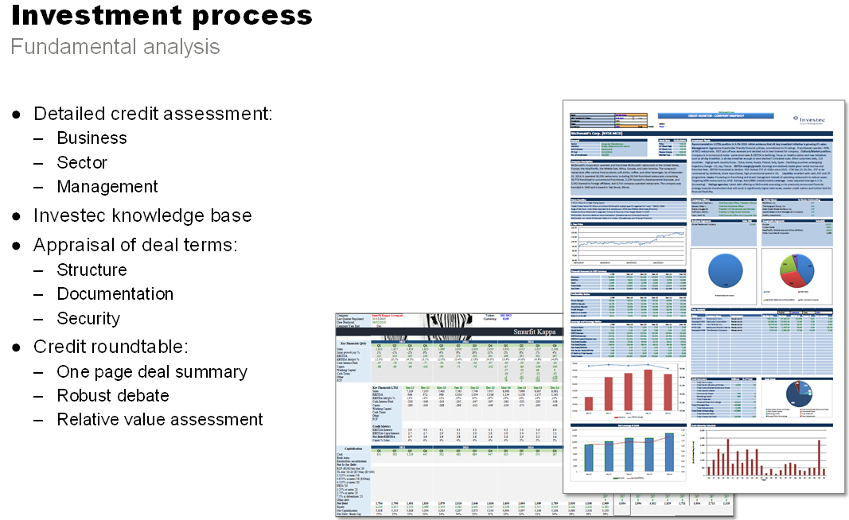
Market based risk: Credit - bank
Definition | IAM philosophy | Investment Implication | Monitoring and Controlling
The risk of receiving back less than the face value of the investment through actual default or a change in the market’s assessment of default probability | Preservation of principal value is the dominant objective of our Reserve Management clients | Credit risk averse. Do not chase yield from bank borrowers. The higher their bid, the more they need the money. Portfolios therefore far more conservative then mandates allow | Metrics include rating changes, credit default swap movements, equity prices, reliance on wholesale funding, leverage ratios and country of residence. Required reading: financial stability reviews
The private sector cannot produce risk-free assets

Slide 9
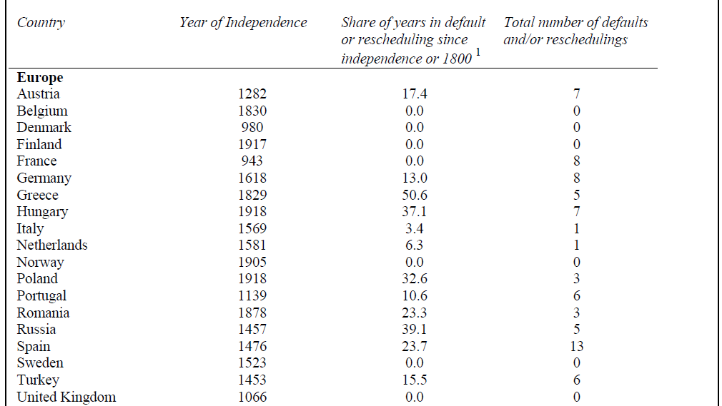
Market based risk: Credit - sovereign
Definition | IAM philosophy | Investment Implication | Monitoring and Controlling
The risk of receiving back less than the face value of the investment through actual default or a change in the market’s assessment of default probability. Increasingly, negative yields will lead to a similar outcome | Preservation of principal value is the dominant objective of our Reserve Management clients | Credit risk averse. A recent development is to avoid markets with negative yields; this will guarantee investors lose money. Except in cases where we think rates will go lower or hedged yield in positive. | Monitor correlation with risk free assets, read IMF Fiscal Monitor. Respect history..
…Respect history. Reinhart & Rogoff have shown us that Greece has been in default for 50.6 of the time since independence
Source: This Time is Different: A panoramic view of eight centuries of financial crisis, Reinhart & Rogoff, NBER WP 13882, March 2008

Slide 10
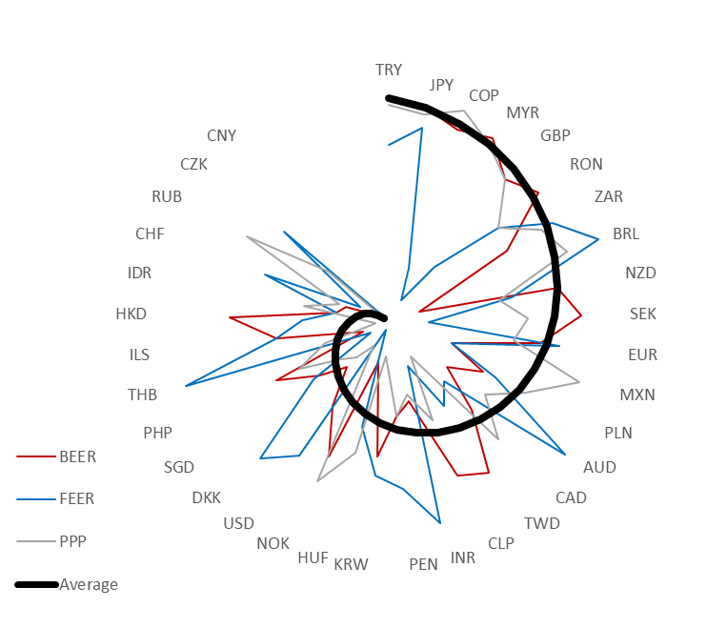
Market based risk: Currency
Definition | IAM philosophy | Investment Implication | Monitoring and Controlling
The risk of receiving back less than the invested proceeds through currency depreciation relative to benchmark or liabilities | We believe that active positioning in currency is a source of uncorrelated returns over the medium term | Willing to take positions that deviate from benchmark as Strategic Themes. Avoid short term positions | Part of our systematic process; set out rational and risks to view. Monitor both and change view if necessary
USD Compelling Forces Scorecard
Fundamentals | Cyclical score | -1.0 | Data appears to be slowing, surprises are very weak and inflation is undershooting
 | Country specific score | 0.0 | Politics seem to be offsetting pro-growth agenda. Score neutral awaiting clarity
 | Structural score | -1.0 | Inequality, low productivity, ageing population and low neutral rates are headwinds.
 | Monetary policy regime | +1.0 | Fed is forcing up real yields. This should be USD positive
Valuation |  | -1.0 | 1 SD Expensive
Market Price Behaviour | Technical Score | +0.5 | USD looking oversold and well off highs
 | Positioning Score | +0.5 | Fast money now short USD
Total |  | -0.25
…systematic process. Our FX scorecard monitors currency relative to a chosen base

Slide 11
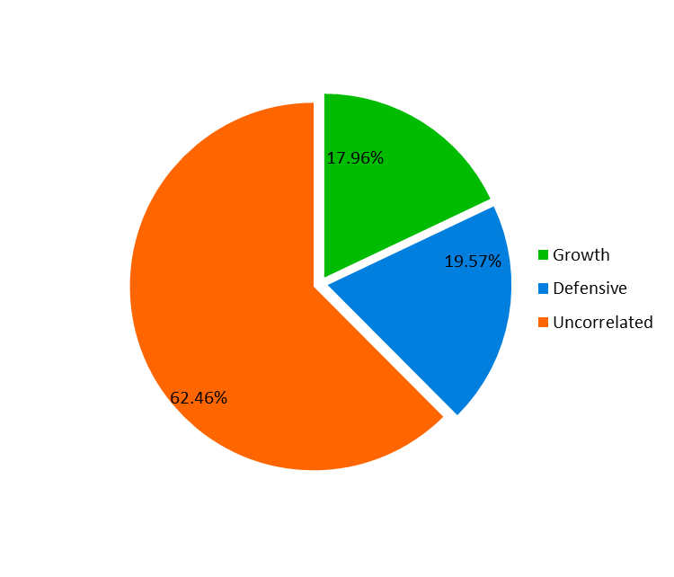
Behaviour not labels- How we think of risk
  One risk number does not explain the story
  Think of the portfolio’s behaviour
  What factors dominate the portfolio’s risk
    Beta
    Correlation

Slide 12
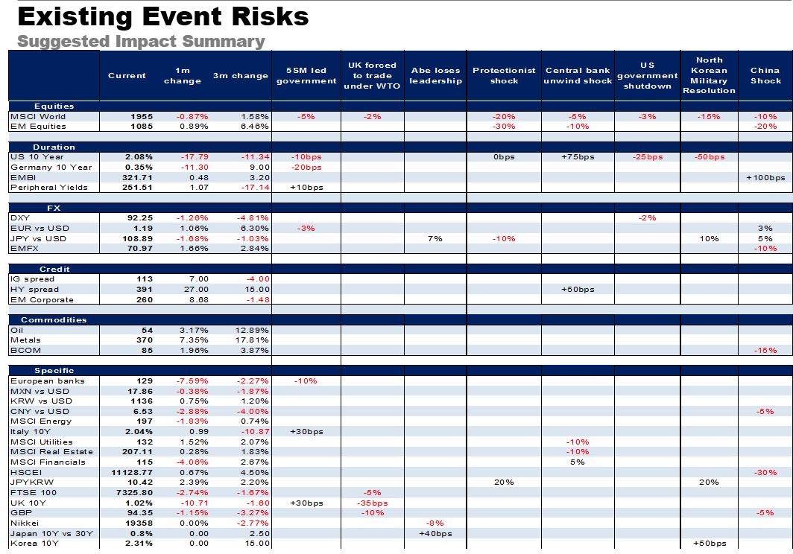
Stress test portfolio for scenarios- event risk
  Monthly meeting
  Propose Events which pose risk to our portfolios
  Try to estimate market impact
  Stress test portfolios
Known | Things we are aware of and understand | Things we are aware of but don’t understand
Unknown | Things we understand but are not aware of | Things we are neither aware of nor understand
 | Knows | Unknowns

Slide 13
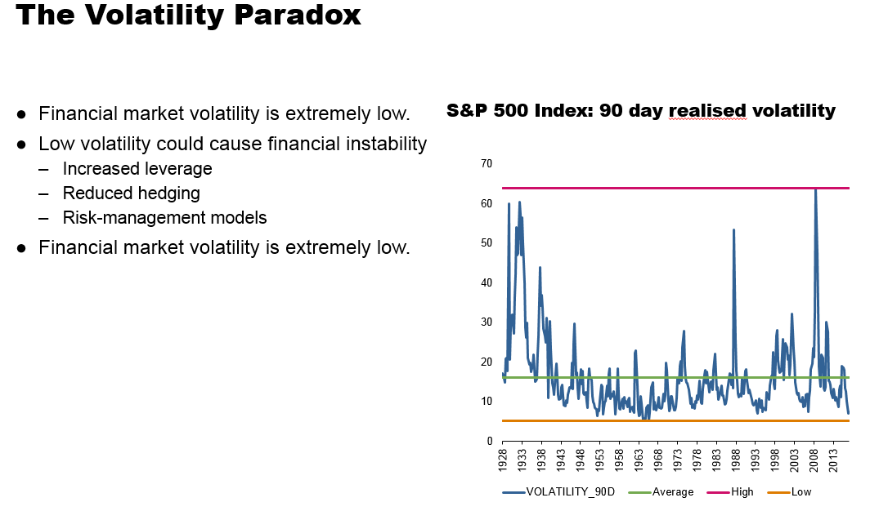
Other points of interest
  Risk limits
    Duration- Does this take curve risk into account?
    Currency- Do we give EM and DM currencies equal weights?
    Credit- Spread duration versus hard % limit
    VAR- Volatility paradox

Slide 14
Thank you
www.investecassetmanagement.com

Slide 15
Important information
GENERIC INSTITUTIONAL DISCLAIMER
All information and opinions provided are of a general nature and are not intended to address the circumstances of any particular individual or entity. We are not acting and do not purport to act in any way as an advisor or in a fiduciary capacity. No one should act upon such information or opinion without appropriate professional advice after a thorough examination of a particular situation. We endeavour to provide accurate and timely information but we make no representation or warranty, express or implied, with respect to the correctness, accuracy or completeness of the information and opinions. We do not undertake to update, modify or amend the information on a frequent basis or to advise any person if such information subsequently becomes inaccurate. Any representation or opinion is provided for information purposes only.
In In the event that specific funds are mentioned please refer to the relevant fact sheet in order to obtain all the necessary information in regard to that fund.
Collective Investment scheme funds are generally medium to long term investments. The value of participatory interests may go down as well as up and past performance is not necessarily a guide to the future. Funds are traded at ruling prices and can engage in borrowing and scrip lending. A schedule of charges, fees and adviser fees is available on request from the manager. Additional adviser fees may be paid and if so, are subject to the relevant FAIS disclosure requirements.
Investment Team: There is no assurance that the persons referenced herein will continue to be involved with investing for this Fund, or that other persons not identified herein will become involved with investing assets for the Manager or assets of the Fund at any time without notice.
Investment Process: Any description or information regarding investment process or strategies is provided for illustrative purposes only, may not be fully indicative of any present or future investments and may be changed at the discretion of the manager without notice. References to specific investments, strategies or investment vehicles are for illustrative purposes only and should not be relied upon as a recommendation to purchase or sell such investments or to engage in any particular strategy. Portfolio data is expected to change and there is no assurance that the actual portfolio will remain as described herein. There is no assurance that the investments presented will be available in the future at the levels presented, with the same characteristics or be available at all. Past performance is no guarantee of future results and has no bearing upon the ability of Manager to construct the illustrative portfolio and implement its investment strategy or investment objective.
Certain Investec Asset Management funds are offered as long-term insurance policies issued by Investec Assurance Limited, a registered insurer in terms of the Long-term Insurance Act.
This presentation is the copyright of Investec and its contents may not be re-used without Investec’s prior permission.
Investec Asset Management is an authorised financial services provider.

