Slide 1
MEFMI Country Presentations – Namibia – 17 October 2017

Slide 2
Presentation Outline
Overview of the Namibian NPS
Legal and Regulatory Framework
Infrastructure Development
Institutional Arrangements (Internal and External)
Coordination and Cooperation
Challenges, Lesson Learned and Opportunities

Slide 3
The Namibian National Payment System
NPS
The Namibian NPS is made up of:
4 systems
4 PCHS, 9 Bank Institutions & 12 Service Providers
1 Independent Automated Clearing House (ACH)
1 RTGS – residing at the Central Bank
Variety of payment instruments

Slide 4
The Namibian National Payment System (Cont’d)
9 banks
Bank of Namibia
12 service providers
ATM Solutions
eCentric
1 Payment Clearing House
Bank Atlantico
Bank BIC
Bank Windhoek
First National Bank
Nedbank
Standard Bank
Letshego Bank
Trustco Bank
Fidel Ipumbu Mobile Technology
Hyphen Technology Namibia
Innervation
Namclear
National Payment System
PayMate
Realpay
Smart Switch
Virtual Card Services
PCH Paper
PCH Immediate Settlement
PCH Electronic Funds Transfer
PCH Card
No CSD in place - plans and collaboration efforts with various stakeholders are currently underway
PFMI Principles have been adopted However no designations were done do date
Self assessment was performed on the RTGS (Namibia Interbank Settlement System - NISS), however the results were not published
Plans are underway to designate FMI’s ( RTGS and ACH) and publish results for the self assessment

Slide 5
Legal and Regulatory Framework…

Slide 6
Legal and Regulatory Framework
Key Mandate
Payment Systems Management Act, as amended (Act No. 18 of 2003) - To ensure the safe, secure, efficient and cost-effective operation of NPS; to determine standards to ensure that bank fees and charges payable by customers are:
in the public interest;
promoting competition;
efficient; and
cost-effective.

Slide 7
Infrastructure Developments
Based on our Key Mandate
Safe, Secure, Efficient and Cost-effective National Payment System
Cheque Phasing Out by 31 December 2017 (≤ N$100 000.00)
Implementation of EMV, PCI-DSS and 3D Security Compliance Projects
Enhanced EFT Project and
Completed the PFMI self-assessment, yet to be published
Promote Financial Sector Development
Efficient, Cost-effective and Competitive Pricing of Payment Services in the Namibian Banking Sector (Costing Survey)
Comparison of Fees and Charges Project
Development of NPS Vision 2020
National Central Securities Depository (CSD) – in progress
NISS Version Upgrade and Implementation Additional Modules
Communication Strategy to Educate Public on Payment Systems
Domestic Proprietary Cards
Promote Regional Integration
SADC Regional Integration (SIRESS) (i.e. SADC Regional Clearing House)

Slide 8
Institutional Arrangements

Slide 9
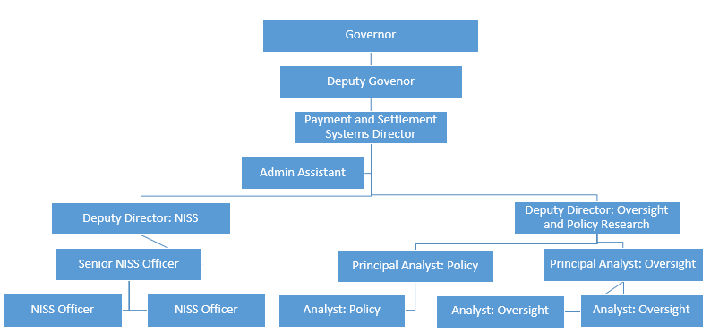
Institutional Arrangements - Internal

Slide 10
Coordination and Cooperation
MoU – Communications Authority of Namibia (CRAN) - Domestic
MoU – Namibia Financial Institutions Supervisory Authority (NAMFISA) - Domestic
MoU - Cooperation with other relevant central banks (e.g. SARB) – Regional and International
MoU – Payments Association of Namibia
MoU – Bankers Association of Namibia

Slide 11
Challenges, Lesson Learned and Opportunities
Collaboration on national and regional projects i.e. Complexity of the Enhanced EFT Project and SADC Low Value Credit Transfer Project
Resource constraints and prioritisation of projects
Aging payments infrastructure – ACH i.e. paper stream
Legal Framework amendment to Accommodate Cheque Phasing Out – various regulations that mandate the use of cheques as a payment instrument.
Lack of Payment Systems Skills in Namibia
Suspension of a participant (Small and Medium Enterprises Bank – SME Bank) from the NPS – Provisional Order for the winding up was issued by the High Court

