Slide 1
BANK OF TANZANIA Regional workshop on Practical Applications of Payment Systems Operations and Oversight
October 2017
Windhoek – Namibia

Slide 2
Outline
Current legal and regulatory framework
Infrastructural development (Payment systems modernization initiatives)
High Value and Retail Payments
Cross Border Payments
Mobile Payments
Institutional arrangements
Coordination and cooperation with other regulators (both domestic and international)
Challenges, lessons learned and Opportunities
Way forward

Slide 3
Infrastructure Development (RTGS)
RTGS systems process and settle large-value payment instructions on an individual basis throughout the day across accounts
Tanzania Interbank Settlement System (TISS)
Held at the Central Bank.
The systems operate on a real time basis and guarantee the finality of settlement in TZS and USD.
Operational since 2004
All participants are bound by
Rules & Procedures and
“Agreement for Participating in the RTGS” signed by the RTGS participants

Slide 4
Infrastructure Development (RTGS)
Participants
Commercial Banks
Government through LGAs, Revenue Authority and Dar Es Salaam Stock Exchange
Facilitate net settlement of obligations for (ACH),
The CSD for Government securities operated by the Bank of Tanzania. Facilitates net settlements & DVP
Payment switches (VISA, MasterCard, UMOJA)

Slide 5
Infrastructure Development - Mobile Payments
A strong mobile phone market penetration
Wide mobile network coverage
Mobile money transfers operators (MNOs), M-Pesa Vodacom, Tigo-Pesa, Airtel money and Zantel
Agent banking
Mlobile banking
Interoperability of mobile money payments

Slide 6
Infrastructure Development (ACH)
Tanzania Automated Clearing House (TACH)
Operational since April 2015
Cheques & Credits Electronic transfers
Direct debits**
TACH aims at enhancing efficiency to clear payment instruments (T+ 1)

Slide 7
Infrastructure Development - Cross Border Payments
These are East African Payment System (EAPS) transfers that use EAC Currencies across the EAC region.
Currently active currencies in the system are TZS, UGX, RWF and KES,
RTGS in East Africa
Kenya Electronic Payment and Settlement System (KEPSS)
Tanzania Interbank Settlement System (TISS)
Uganda National Interbank Settlement (UNISS)
Rwanda Integrated Payment Processing System (RIPPS)
Mobile money transfers
Vodacom Tanzania and Safaricom Kenya
Tigo Tanzania and Tigo Rwanda

Slide 8
Infrastructure Development - Cross Border Payments
SIRESS Implementation, 6 commercial banks joined. Mostly with business related to South Africa

Slide 9
Current legal and regulatory framework
NPS Act 2015
Regulations for facilitating the Act
Payment Systems Licensing and Approval Regulations 2015
Licenses to Payment Systems Providers
Electronic Money Issuance Regulation 2015
Separate/subsidiary company for MNOs ( safeguard customers interests since Mobile money is not the core function of the MNOs
Remittances (remittances are informal)
AML/CFT Act

Slide 10
Coordination and Co orperation with other Regulators
Local
Tanzania Communications Regulatory Authority (TCRA)
Financial Intelligence Unit (FIU),
Ministry of Finance (MOF)
The Capital Markets and Securities Authority (CMSA) is a Government Agency established to promote and regulate securities business in the country.
It was established under Capital Markets and Securities Act, 1994.
International bodies
World Bank
Regional integration bodies (EAC, SADC, AFI, …..)

Slide 11
Challenges - Cross border payments
EAPS..
Challenges from the existing architecture
Delay in processing transactions from the 3 systems
Maintenance for the 3 systems is huge
Countries are at different levels of development
Currency compatibility
Interoperability of Mobile Payments

Slide 12
Challenges…
Interoperability of Mobile Payments
RTGS Modernization Project
Due to various demands and developments for new functionalities (Multi-currency and Interfaces for Revenue Authority, Ministry of Finance and DSE)
Technology: Payment system to meet international standards e.g. ISO 20022 Compliance
Developing efficient payment systems in the country and to meet the broader needs of the economy.

Slide 13
Challenges…
Innovations in payment systems tend to be ahead of regulation
Lack of skills- capacity building is necessary as new technologies lead to the emergence of new payment products in the financial services space
High transaction cost
Low Literacy/awareness Level

Slide 14
Way forward
Support modernization process
Support the existing payment systems (Clearing and settlement systems)
System enhancements
EAPS 2
TISS Modernization (ISO 20022)
Enhancement of the legal and regulatory framework
Working with partner states to harmonize payment systems

Slide 15
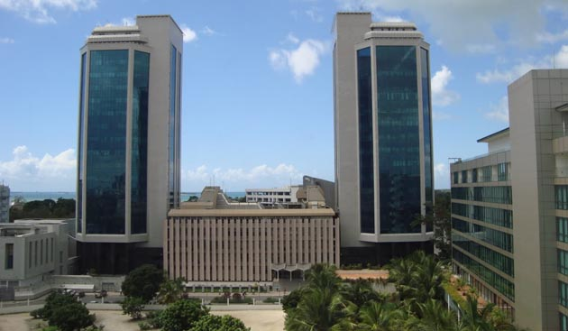
Ahsante
Bank of Tanzania

