Slide 1
APPROACH TO PAYMENT SYSTEMS OVERSIGHT (Zimbabwe Presentation)
MEFMI Regional Workshop
Namibia: 16-24 October 2017

Slide 2
Outline
Current Legal and Regulatory Framework
Infrastructure Development/PS Modernisation Initiatives
Institutional Arrangements
Coordination and Cooperation with other Regulators
Challenges, lessons learnt and Opportunities
Conclusion

Slide 3
Introduction
Zimbabwe is a landlocked country bordered by Zambia, Botswana, Mozambique and South Africa. The land area is 390,757 square kilometres.
The 2014 Labour Force Survey estimated the Zimbabwe population as shown in table below:
The mobile penetration rate (active) for 2016 Q4 increased by 0.5% to reach 94.8% from 94.3% recorded in the previous quarter ending 2016 Q3. The internet penetration rate as at Q4 2016 was 50% (POTRAZ Q4 Report).
Male | Female | Total
6,485,676 | 6,961,610 | 13,447,286
48% | 52% | 1

Slide 4
Zimbabwe Map

Slide 5
Payment Systems Oversight
Central Bank function whereby the objectives of safety and efficiency are promoted through monitoring and assessing existing and planned systems and where necessary to induce change. (BIS)
Ensuring the smooth and efficient functioning of payment systems by enforcing effective risk management mechanisms.
Implementing principles and rules.
Assessment and enforcement of rule compliance by system operators and participants.
Promoting and coordinating individual and collective payment systems initiatives.
Ensure that payment system operators and participants are operating responsibly, not prejudicing the clients and ensuring that customers get redress on their complaints.

Slide 6
Legal & Regulatory Framework

Slide 7
Other Regulatory Support
Bills of Exchange Act, Directives, Circulars, MOUs
International Standards- 24 PFMIs, FATF
Guideline for electronic payments/ Retail Payment Systems and Instruments
Oversight Framework & framework for recognition of payment systems
Rules, constitutions and Agreements for respective FMIs
Consumer Protection Framework and Bill

Slide 8
RBZ Oversight Scope and Approach
The Reserve Bank of Zimbabwe (RBZ) oversight scope covers large value payment systems (LVPS) and retail payment systems such as cheques, cards, and mobile, among others, also known as system wide important payment systems (SWIPS).
The RBZ, in conducting its oversight activities, uses the risk based approach, standard based approach or a combination of the two:-
Risk based oversight is a forward-looking approach that allocates resources based on risk characteristics of a payment system.
Standard based- Individual systems are regularly assessed to ensure compliance to international best practice and standards.

Slide 9
Payment Systems Developments
Technological evolution –bringing in new face to payment systems and financial services sector at large - e.g. mobile, NFC, QR Codes, social media
Market developments - changing business models
- Changing consumer expectations and behaviour, consumer protection guideline.
PS technology driven- dynamic and unfolding development
- MFS- branchless banking, Online Banking Apps - convenience of financial services anywhere, anyplace, anytime
Global reach of internet, cards and other electronic devices
- Mobile and online payments -more pronounced.
Financial instruments dematerialised

Slide 10
Zimbabwe PS – Infrastructure Development
1996 to
2000
2001 & 2002
2004-2005
2006-2008
2009-2011
2014
2015
2016 & 2017
NPS Reform initiative 2. NPS Framework & Strategy
3. NPS Division Established
NPS Act
2. ZETSS goes live
1. Oversight Unit
2. Same Day Clearing
3. eFS goes live
4. RTGS Upgrade
1. CSD
(Gvt goes live)
2. STP Completion 3. CSD upgrade
ZSE ATS
2. RTGS upgrade
3. NFC
1. CSD (equities) goes
live
2. SIRESS
3. REPSS
NFIS
2. RTGS Multicurrency Settlement,
3. QR Codes
Mobile Financial Services
Notes:
1996-2000 The first initiative to launch the development of payment systems in Zimbabwe was in 1995 when a Payment Systems Task Force (PSTF) was set up to establish the Zimbabwean payment systems and to recommend the way forward. Prior to 1995, the Zimbabwean payment system was marred with manual, labour intensive, cumbersome and inefficient paper based systems with the cheque payment stream being the only payment stream directly under the supervision of the central bank.
2001 Cognizant of the international requirements for all payment systems to have a sound legal basis under all relevant jurisdictions, Zimbabwe promulgated the NPS Act in November 2001.
2002 Nov 18 RTGS went live
2004 Jan Other financial institutions were connected onto the RTGS whilst Oversight unit was formed in July 2004
2005 Nov The eFS system is a Central Bank reporting system that enables full trace functionality as to source and destination of funds. The system contributes to the country’s compliance with anti-money laundering reporting requirements and strengthens the Bank’s capacity to monitor transaction flows within the financial sector.
2006 Feb CSD is a securities system that is used to manage and administer securities issued by the government and Central bank. The nature of the securities vary from OMOs, TBs and any other securities that might be issued by the central bank or government. The securities or assets might be physical or in dematerialised form. The systems is interfaced with RTGS, thus achieving DVP.
2007 Sept Swiftnet Phase 2 Migration-The main difference between Phase 2 and the previous arrangement is that Phase 2 requires banks connecting to the network to use a Relationship Management Application (RMA) instead of the previous Bilateral Key Exchange (BKE) system.
2008 Aug Straight Through Processing (STP) is a solution that automates the end to end processing of transactions for all financial instruments from initiation to settlement. STP was meant to improve operational efficiency by minimizing or eliminating human intervention during transaction processing. The increase in volumes of transactions coupled with the human intervention aspect in the financial industry leads to operational risk. The STP was however shelved due the economic challenges being faced.
2007 & 2008 CSD upgrades were necessitated by the continuous review, to assess its functionality. The main upgrade was for reducing the messages that are generated by the core system were suppressed to limit traffic through SWIFT, new inquiry inbox in WEB, position monitor in CSD Administration reactivated and the Database to ensure a quick open of the transaction screen and enhancement of some reports
2009 Jul Currency Code changed from ZWD to ZWL on 10 July 2009

Slide 11
Zimbabwe PS Architecture
Financial
INTERNATIONAL & REGIONAL PAYMENT SYSTEMS
SETTLEMENT HUB
RTG-21FIs
CSD – Govt
CSD - Equities
RETAIL PAYMENT SYSTEMS
Environmental
Risks
SIRESS
REPSS
Economic
Transacting Public
EFT
Internet
Technological
Institutional
-MFS
-Agents
Cheque
Legal
Cards
POS
ATMs
Business
SWIFT

Slide 12
Payment Systems Access Points and devices
Payment Systems Access Points
 | 2012 | 2013 | 2014 | 2015 | 2016 | September 2017
ATMs | 375 | 431 | 538 | 556 | 569 | 563
POS | 4,258 | 6,901 | 12,612 | 16,363 | 32,629 | 50,418
Mobile banking Agents | 3,223 | 6,900 | 25,618 | 38,745 | 40,590 | 44,793
Payment Systems Access Devices
Debit Cards | 1,582,480 | 2,246,659 | 3,613,781 | 2,365,160 | 3,127,153 | 4,186,957
Credit Cards | 8,548 | 7,221 | 9,547 | 10,854 | 16,030 | 17,806
Prepaid Cards | 292,303 | 17,599 | 28,881 | 30,125 | 43,288 | 62,517
Active Mobile Banking Subscribers | 826,442 | 2,444,340 | 6,060,630 | 4,683,959 | 3,279,049 | 3,821,865
Active Internet Banking Subscribers | 40,920 | 52,105 | 78,548 | 108,662 | 168,339 | 250,681

Slide 13
Retail Payment Streams Values and Volumes
PAYMENT STREAMS | 2009 | 2010 | 2011 | 2012 | 2013 | 2014 | 2015 | 2016 | September 2017
 | VALUES IN MILLIONS
CHEQUE | 5.07 | 42.41 | 64.38 | 72.56 | 142.84 | 131.79 | 144.13 | 113.08 | 55.55
POS | 9.31 | 54.73 | 248.6 | 741.81 | 1,450.47 | 1,527.57 | 1,723.03 | 2,898.44 | 4,501.28
ATMS | 21.06 | 312.82 | 902.41 | 1,624.00 | 2,381.86 | 3,187.77 | 3,854.34 | 2,283.53 | 376.4
MOBILE | 0.62 | 1.2 | 8.1 | 381.61 | 2,091.01 | 3,634.40 | 4,645.89 | 5,815.86 | 10,002.29
INTERNET | 23.48 | 123.9 | 532.08 | 1,102.11 | 1,361.83 | 1,223.00 | 1,614.13 | 2,503.91 | 4,400.85
TOTAL VALUE | 59.54 | 535.06 | 1,755.57 | 3,922.09 | 7,428.01 | 9,704.53 | 11,981.52 | 13,614.82 | 19,336.37
 | VOLUMES IN MILLIONS
CHEQUE | 0.02 | 0.17 | 0.26 | 0.29 | 0.38 | 0.37 | 0.36 | 0.35 | 0.22
POS | 0.4 | 1.28 | 4.34 | 8.71 | 12.01 | 14 | 14.54 | 52.41 | 141.57
ATMs | 0.33 | 1.98 | 4.14 | 6.78 | 9.63 | 12.14 | 13.41 | 12.33 | 6.93
MOBILE | 0.2 | 0.42 | 2.3 | 19.96 | 119.14 | 178.51 | 228.2 | 298.59 | 446.06
INTERNET | 0.02 | 0.05 | 0.22 | 0.32 | 0.45 | 0.41 | 0.56 | 1.11 | 2.77
TOTAL | 0.97 | 3.9 | 11.26 | 36.06 | 141.61 | 205.43 | 257.07 | 364.79 | 597.55

Slide 14
ZETSS Statistics

Slide 15
Institutional Arrangements
GOVERNOR
FINANCIAL MARKETS DIVISION
(Director)
NATIONAL PAYMENT SYSTEMS DEPARTMENT
(Deputy Director, Financial Markets)- Head NPS Dept.
OPERATIONS (ZETSS AND CSD)
OVERSIGHT & RISK MANAGEMENT
POLICY AND RESEARCH

Slide 16
…Institutional Arrangements
The Reserve Bank of Zimbabwe responsibility to supervise, regulate and recognize payment systems operating in Zimbabwe, through NPS Dept.
Financial Stability Committee- members drawn from the Ministry of Finance, Deposit Protection Corporation, Insurance and Pensions Commission, Securities and Exchange Commission of Zimbabwe and the Reserve Bank of Zimbabwe
Zimbabwe National Financial Inclusion Strategy 2016-1020

Slide 17
Coordination and Cooperation with other Regulators
Internal – BS, BUP & SML, Exchange Control, Legal, ICT
Cooperation with other regulators- MoUs.
Securities Commission (SEC);
Insurance and Pension Commission (IPEC);
Competition Commission;
Standard Association of Zimbabwe (SAZ) and;
Posts and Telecommunications Authority of Zimbabwe (POTRAZ);
Regionally and Internationally with other Central Banks

Slide 18
Challenges
Regulation tends to follow innovation and technological developments.
Coordinating oversight, supervision and regulation amongst the different regulators require continuous capacity building.
Non-traditional banking sector players (non -banks)- risk posed by e-money schemes
Risk profiles continuously change and complex to manage- i.e. cyber risk.
Deposit Protection Insurance
Market Discipline- driven by profit motives, laggards in implementation of standards

Slide 19
Lessons
Advance public interest objectives-safety, efficiency, soundness
Capacity building- all stakeholders need to continuously invest in new capabilities and infrastructures to support innovation.
A mix of strong and light touch regulation underpinned by the principle of self regulation/risk management
Continuously improve on Consumer protection
Collaboration and cooperation- Local/regional/international
Reviewing of regulatory framework

Slide 20
Opportunities
A well developed financial infrastructure- banks, large value and low value payment systems, communication networks which can easily integrate
Regulatory framework in place which can easily be developed
A well established supervisory and oversight role
Benefits in terms of wide range of payment platforms & financial Inclusion
Possibility of Interoperability

Slide 21
Way forward
Building capacity in PS
Regulation that not only ensures adequate oversight of payment systems and their associated instruments - but also promotes an enabling environment for positive innovation as well safe and efficient practices.
Establishing & Strengthening cooperative oversight.

Slide 22
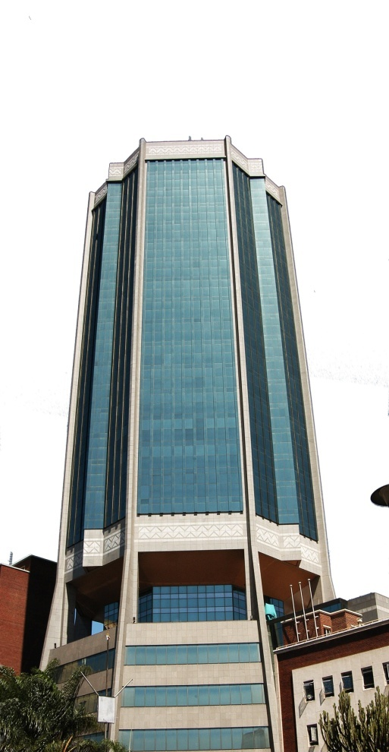
Thank You
Reserve Bank of Zimbabwe

