Slide 1
Cybersecurity And Payments A Primer of the Issues Windhoek, Oct 17 2017 Dr Leon J. Perlman Digital Financial Services Observatory Columbia University, New York

Slide 3
Industrial-scale cyber-gangs
State Actors

Slide 4
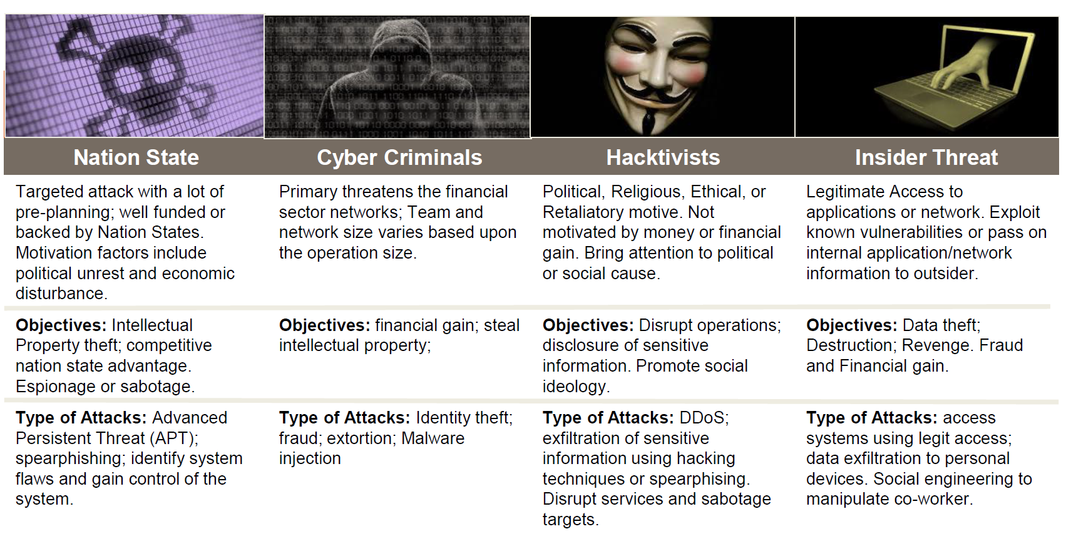

Slide 5
In payments & payment system ecosystems cybersecurity vulnerabilities/risks exist at 3 levels:
Telecommunications & Mobile Network Operator (MNO) level
Attacks/exploitation of telecoms infrastructure
MNOs very vulnerable
SS7 network (USSD), base stations
Financial infrastructure level
Attacks on CB, bank, switch, and MFSP networks
Phishing (eg BB/SWIFT)
Customer handset security
Application security
SIM swaps
Phone number spoofing
SMS and email phishing
Fake phones
Customer Level

Slide 6
EXAMPLES OF THREATS & INTRUSIONS

Slide 7
MNO Level: Risks and Vulnerabilities
Signaling System 7 (SS7)
1975-era telecommunication protocol still used by most fixed and mobile operators around the world to allow their mobile and fixed line networks to interact (no security!)
SS7-based networks around the world are connected to one another
GSM
USSD
Mobile
MAP
SS7
Infrastructure
Unstructured Supplementary Service Data (USSD)
An active GSM mobile technology protocol that uses SS7 to allow mobile handsets to communicate with the MNO or service provider's computers in real-time
USSD based on Mobile Application Part (MAP)
Used globally for user MFS access
SS7 = USSD = Vulnerable

Slide 8
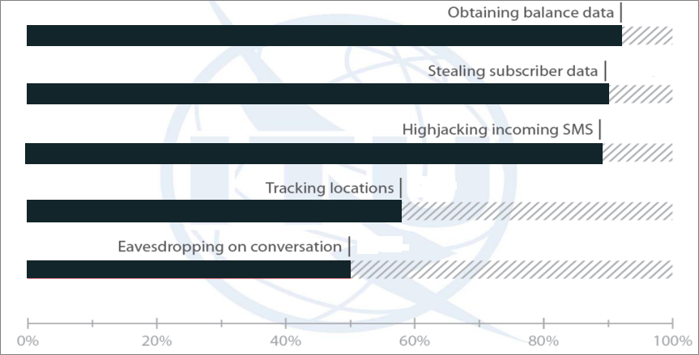
Effect of MNO-level Exploits via SS7 & USSD
Move funds in Mobile Money
Current intrusion vulnerabilities – percentage success across 12 MNOs tested

Slide 9
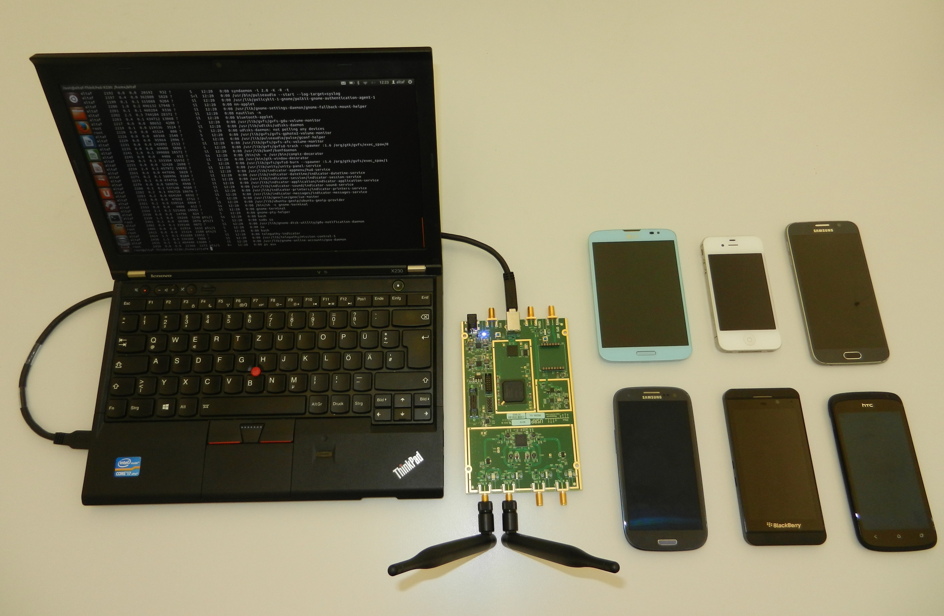
MNO Level: Fake Base Stations Steal MFS Value
DIY IMSI Catcher (sub-US$400 total)
‘HackRF’ radio baseband board (US$174 on ebay)
Free OpenBTS software

Slide 10
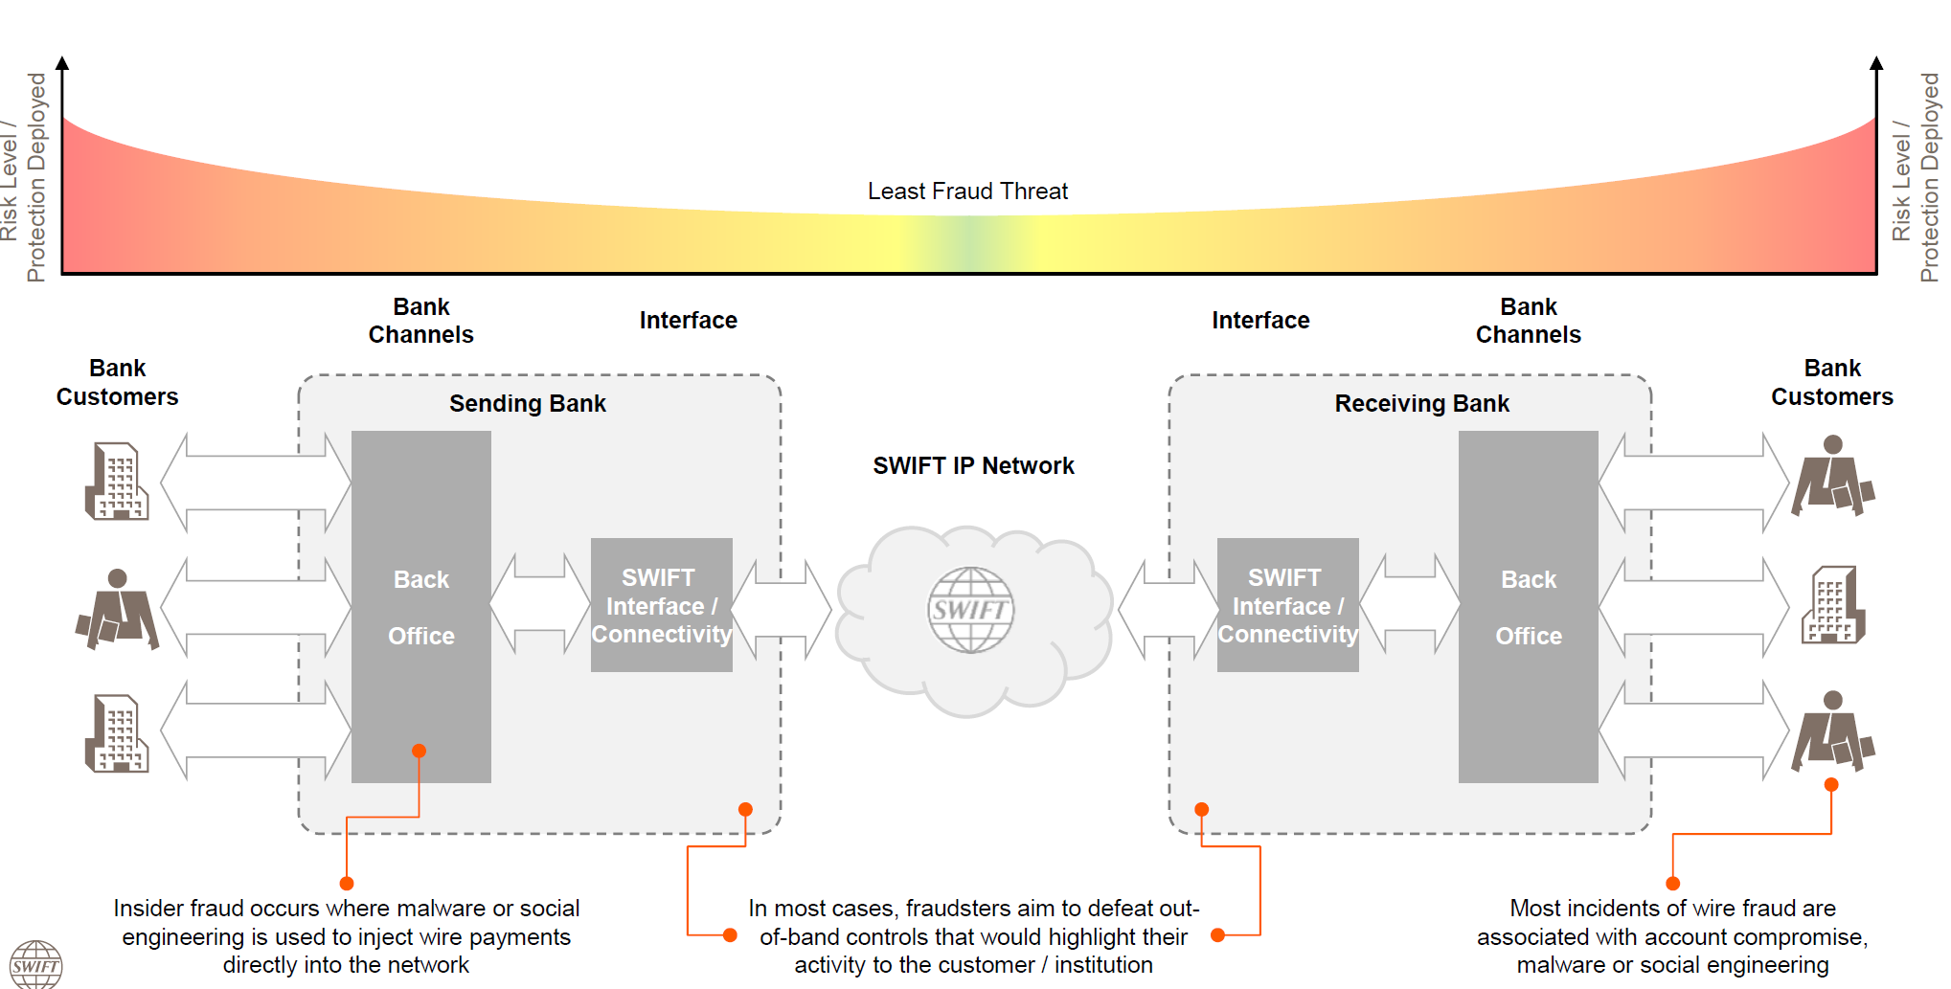
Financial Infrastructure

Slide 11
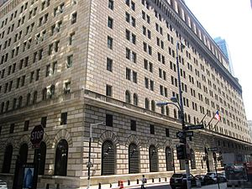
Bangladesh Bank (Feb 2016)
"Bangladesh Bank Heist“
Thieves compromised BB's computer network, observed how transfers done, and gained access to the bank's SWIFT credentials.
Instructions to withdraw US$951m Bangladesh Bank account issued via SWIFT
5 transactions ($101m) taken from BB account @Federal Reserve Bank, New York
$20m to Sri Lanka (recovered) & $81m to Philippines ($18m recovered)
NY Fed blocked remaining 30 transactions of $850m
Dridex malware was used for the attack
FBI says North Korea behind theft
SWIFT has advised banks using the SWIFT Alliance Access system to strengthen their cyber security posture and ensure they following SWIFT security guidelines.

Slide 12
MFS App Vulnerabilities
 | GCash | Philippines
 | Zuum | Brazil
 | MCoin | Indonesia
 | Money on Mobile | India
 | Mpay | Thailand
 | Airtel Money | India
 | Oxigen Wallet | India
University of Florida: Brad Reaves, Nolen Scaife, Adam Bates, Patrick Traynor, and Kevin Butler

Slide 13
Cybersecurity/payment standards, risk frameworks/policies
versus Evolving, unique security challenges of new ecosystems

Slide 14
Dealing with Cyberthreats & Cyberattacks:
Then: Protection and Response
Now: Cyber resilience

Slide 15
Cyber Risks Are Unique
Persistent nature of a campaign conducted by a motivated attacker (Israel/NSA in Kaspersky)
Broad range of entry points through which an FMI could be compromised (interconnected)
Cyber attacks can render risk management & business continuity arrangements ineffective (replication)
Cyber attacks stealthy and propagate rapidly within a network of systems (exploit unknown vulnerabilities)
Require capabilities to swiftly detect, respond to, contain and recover from such attacks (in 2 hours?)

Slide 16
General Industry/Consumer Challenges in Responding To Cybersecurity Threats
Inadequate resources for Cybersecurity initiatives
Heavy reliance on external expertise and solutions
Poor customer awareness of Cybersecurity
Lack of collaboration/info sharing amongst SPs from competition issues
Rise in Phishing and Pharming attacks
Insider-aided frauds and cyberattacks
Security regulations seen as restrictive
Frequency of regulations and implementation demands on regulated entities
Budgetary constraints for meeting some regulatory requirements

Slide 17
General Regulatory Challenges in Responding To Cybersecurity Threats
Adequate capacity and tools for Cybersecurity supervision
Inadequate resources for Cybersecurity initiatives
Lack of coordination between regulators
Heavy reliance on external expertise and solutions
Insider-aided frauds and cyberattacks

Slide 18
BIS - Guidance On Cyber Resilience For FMI
Committee on Payments and Market Infrastructures (CPMI) and the International Organization of Securities Commissions (IOSCO) published Guidance on cyber resilience for financial market infrastructures in July 2016
“The safe and efficient operation of financial market infrastructures is essential to maintaining and promoting financial stability and economic growth.”

Slide 19
BIS - Guidance On Cyber Resilience
Rationale:
Ability of FMIs to pre-empt cyber attacks
Respond rapidly and effectively to cyberattacks
Achieve faster and safer target recovery objectives if the attacks succeed.
Provides authorities with internationally agreed guidelines on oversight and supervision of FMIs in cyberrisk.
Guidance does not establish additional standards beyond PFMI, is supplemental to the PFMI

Slide 20
BIS - Guidance On Cyber Resilience
Sound cyber governance is key.
Board and senior management attention is critical to a successful cyber resilience strategy.
The ability to resume operations quickly and safely after a successful attack
FMIs should make use of good-quality threat intelligence and rigorous testing.
FMIs should aim to instil a culture of cyber risk awareness and demonstrate ongoing re-evaluation and improvement of their cyber resilience at every level within the organisation.
Cyber resilience cannot be achieved by an FMI alone; it is a collective endeavour of the whole “ecosystem”.

Slide 21
ROLE OF THE CENTRAL BANK
Pay close attention to the associated risks, particularly those related to cyber resilience and transaction security.
Invite various players in the payments market reinforce the security of their information systems against cyber attacks and to strengthen the capacities of their human resources and implement strong tools and methods of detection of intrusions.
Identify critical infrastructures to maintain the cyber-resilience of FMIs
Work on a collaboration with the Information Systems Security Department.

Slide 22
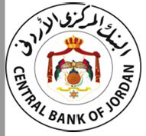
Regulatory Initiatives On Cybersecurity
Regulations should balance between risks and efficiency
Regulations should be risk-based, flexible and innovative and relaxed
"Central banks should be willing to take some risks".
They should NOT implement a traditional risk matrix.

Slide 23
MOROCCO: CENTRAL BANK issued a a cyber resilience Circular for banks, financial institution and FMI’s listing the main security principles to respect and obligations of reports

Slide 24
MOROCCO: Cyber-resilience Responsibilities of Notified FMIs
Report any Cyber-security incident to ma-Cert
Ma-Cert: Moroccan Computer Security Incident Response Team within the National Defense Ministry
Identify its sensitive information systems according to the stated principles
Host sensitive data on national territory
Classify impact based on scale established by decree
Implement a Business Continuity Plan
Conceive a robust cyber-security framework for risk identification and incident management

Slide 25
JORDAN:
Central Bank “Cyber Security Resilience instructions for banks and financial institutions”
Cyber Governance including acts about establishing Cyber Security policy and cyber security program for Banks and financial institutions
Cyber risk Management including acts about identifying critical operation and information assets in Banks and financial institutions and how to assess cyber risks
Security controls for the information assets and the technology environment including acts specific for email security in Banks and financial institutions to mitigate cyber risks including:
Detection of cyber attacks
Response to cyber incidents
Penetration tests to evaluate the efficiency of the security controls
Outsourcing
Awareness and training

Slide 26
JORDAN: Risk Management Framework For JoMoPay Mobile Switch

Slide 28
Response & Monitoring of Threats
CERT : Computer Emergency Response Team
Expertise, forensic and response international network
CSOC : Cyber Security Operation Center
Local monitoring of threats
Regional CSOC
April 2017 : Launch in Dakar in with regional capability
August 2017: Proof of concept with 50 MFIs to fine tune methodology, tools, procedures, training material, business case, Pricing
October 2017 : Senegal roll-out open to 11 Tier I & II MFIs

Slide 29
Summary
Cyber resilience now, versus protection and response previously
New exploits and vulnerabilities are real
MFS vulnerabilities are not properly ventilated vs payment security
Are existing cybersecurity standards enough to prevent/mitigate exploits & vulnerabilities?
Regulations should be risk-based, flexible and innovative and relaxed
Need proper risk management frameworks that address MFS directly, not payment security and cyber-resilience only
Need cyber-resilience frameworks (Red Teams)
Need regulatory coordination (MoUs) (and PPP) between Central Banks, Telecommunications regulators, ICT Ministries and data protection regulators that directly address:
Risks
Prevention
Mitigation
Proper, real-time reporting
Proper oversight

Slide 30
Resources
The Bank for International Settlements
ISO 27032 (Guideline for Cybersecurity)
G7 Fundamental Element of Cybersecurity for The Financial Sector
National Institute of Standards and Technology (NIST)
ITU DFS Focus Group
FIGI Initiative

