Slide 1
BEST PRACTICES IN DESIGN AND IMPLEMENTATION OF FINANCIAL LITERACY PROGRAMS
Market Conduct Supervision Training Program
Armenuhi Mkrtchyan
6-10 August 2018, Harare

Slide 2
Overview
How to implement effective FE programs?
What are the components of effective FE ecosystem?
What cooperation mechanisms are needed for stakeholders?
What kind of FE programs can be made?
Preconditions for effective ecosystem
National Strategy for Financial Education
Samples of FE programs
Cooperation Mechanisms
Monitoring & Evaluation
Notes:
In the broad sense the framework includes (4 pillars of the market conduct framework):
Laws and regulations (regulatory framework)
Institutional arrangements + mandate
Supervisory tools and enforcement
Arrangements for financial education

Slide 3
Financial Education National Ecosystem

Slide 4
WHY
goal is
Such an ecosystem that would allow effective policy making on financial education. The ecosystem should be viable and sustainable.
WHAT
we need to have
All preconditions in place that will support sustainable ecosystem
HOW
what challenges we face
Reach consensus
Build capacities
Set processes
Raise importance
Raise ownership
Measure the progress
Notes:
Viable – able to live
Sustainable - a system that maintains its own viability by using techniques that allow for continual reuse.
- nationwide consensus, communication platform (Steering Committee, etc), processes, capacities, resources

Slide 5
Preconditions for Effective FE programs
NSFE
Stakeholder Management system
Monitoring, Evaluation, Research
Cooperation Mechanism
Sustainable Funding
Institutional Setup
Regulators
Gov-t
NGOs
Private
FE is nationwide project with multiple heterogeneous stakeholders
Stakeholders – Government, other supervisory authorities private sector, NGOs
FE is vey expensive and alone it will not possible to exercise
NSFE – nationwide consensus pertaining to policy agenda and priorities.
Notes:
All preconditions in place that will support sustainable ecosystem - nationwide consensus, communication platform (Steering Committee, etc), processes, capacities, resources
An ecosystem includes all of the living things (plants, animals and organisms) in a given area, interacting with each other, and also with their non-living environments (weather, earth, sun, soil, climate, atmosphere). ... In an ecosystem, each organism has its own niche or role to play.

Slide 6
Financial Education Dimensions
Setting climate
Monitoring Evaluation
Research
Schools
Farmers
Women
Refugees
…
Targeting
Institutional Setup
NSFE
Cooperation Scheme
Communication Platform
Funding System
Facilitating

Slide 7
fe success depends on
Stakeholder management
National Strategy → all stakeholders ownership, SMART
Monitoring system

Slide 8
NATIONAL STRATEGY FOR FINANCIAL EDUCATION (NSFE)

Slide 9
Why National Strategy?
RECOGNITION of financial education as national priority
Provides a
CLEAR PLAN
Gets SUPPORT of all stakeholders and government
PROMOTES the cooperation and participation of all stakeholders
ENCOURAGES more effective uses of resources
HELPS to avoid unplanned gaps and duplications
When there is:
Low level of financial literacy
Lack of mechanisms of cooperation and of shared vision with all stakeholders
Lack of recognition of financial literacy as national priority
MASTERPLAN
Notes:
Source: OECD
A smoother and more sustainable cooperation between regulator and stakeholders
Avoids duplication of resources
Allows development of articulated and tailored roadmaps with measurable and realistic objectives based on dedicated national assessments
CD

Slide 10
Preliminary steps: designing strategy
Assessment of population needs – baseline survey
Mapping of existing initiatives and resources
Mobilization of resources and identification of stakeholders
Setting Steering Commitee
Define ‘financially capable’ person
Development of NSFE
Competency Matrix – set of topics, capabilities (knowledge, skill, attitude, behavior) and competencies thereof. That defines ‘financially capable person’.
Baseline survey to measure level of financial capability in country and to identify target groups that have relatively low level of financial capability
Steering committee – a coordination and consultation mechanism for development and implementation of National Strategy of Financial Education(NSFE)

Slide 11
KEY COMPONENTS of NSFE
Introduction
Goals
Overarching goal of FE
Measurable Targets
Objectives of NSFE
Situational Analyses
FL level across age, geography, income, …
FE needs of country
Existing initiatives and players
Target groups
Principles of NSFE
Content of financial education
Definition of FL person
FL competencies/thematic areas
Programs of financial education
Monitoring and evaluation
Impact of overall NSFE
Effectiveness of FE programs
Stakeholders Coordination Mechanism
Committee, members, principles of work, roles & responsibilities
Funding
Timeline
NSFE – 20,30 … years
Action Plan – 3-5 years
Action plan

Slide 12
GOALS
Sustained financial well-being of all Zimbabweans through improved financial capabilities
KPIs – measurable targets
Overarching Goal
Objectives of NSFE
Objectives of a Program
Facilitate through
Shared vision, umbrella and guiding map for stakeholders
Sustainable institutional setup
Clear roles, responsibilities and actions
Effective monitoring and evaluation
Implementation of impactful programs
Introduce obligatory FE in schools so that student is fully prepared to make personal financial decision after graduation of tertiary school.
Increase financial capability of rural population
…

Slide 13
GOAL AND OBJECTIVE OF NSFE
Objective of NSFE
Goal
Create and develop necessary institutional framework which will facilitate the population to become financially literate, including
Development of institutional unit and adequate infrastructures
Implementation of financial education projects,
Monitoring of effectiveness of on going projects and implementation of evaluation mechanisms.
“Increase the level of financial literacy of population living in Armenia, which will support to financial stability, financial inclusion and well being of population”
Facilitate vs implement

Slide 14
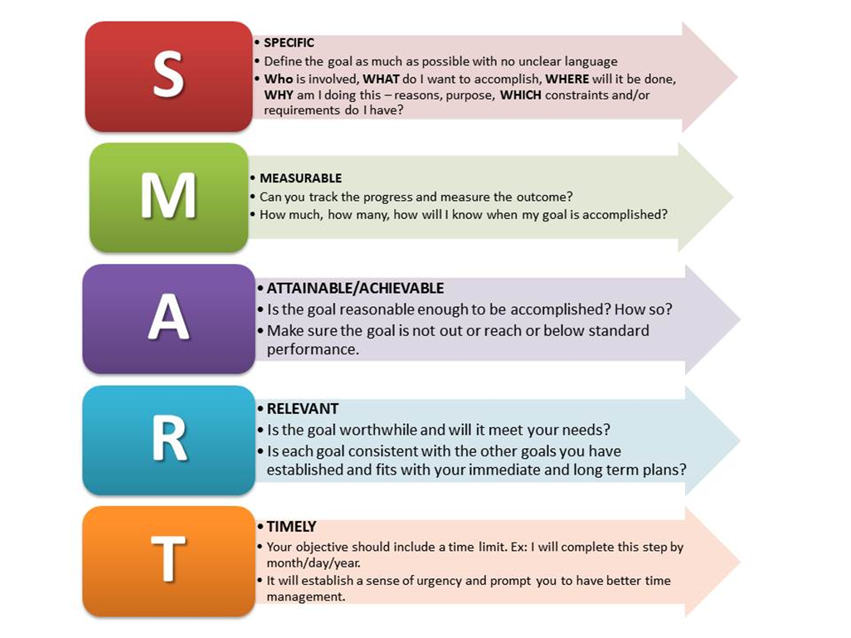
Measurable targets of NSFE
NSFE should provide also measurable targets based on which the progress of NSFE will be measured over years.

Slide 15
Measurable Targets of NSFE
Knowledge vs behavior
other
other
The weight of people who are effectively planning their personal and familiar budget planners
The weight of people who have savings
The weight of people who have banking account or saving account
The weight of people who have credit
The weights of people being financially literate
The weights of people being financially included
Measurable targets may reflect only knowledge part of financial capability or also behavioral part.

Slide 16
Pillars of NSFE
Infrastructure
Research
&
evidence
Education programs
Institutional Setup
Monitoring
&
Evaluation
Strategy, Programs
Coordination cooperation mechanism
Partnerships
Funding
Educational materials, resource hub
Schools, adults, rurals, …
ToT – training of trainers
Websites,
Tools
Databases
Channels
NSFE
Projects
Tests, focus group researches,

Slide 17
PILLARS OF FE PROGRAM
FINANCIAL
EDUCATION
IN SCHOOLS
FINANCIAL
EDUCATION
FOR
ADULTS
TRAINING
OF
TRAINERS
MONITORING AND EVALUATION
TRAINERS
ACTION PLAN (5 YEARS)
Notes:
Principles of integrating financial education in schools
Target: School students of all ages
Compulsory in school
Integration of financial education’s elements in existing subjects
Strong collaboration with Ministry of Education
“Pilot” period
Method of education: education materials in line with games, seminars, visit to financial institutions etc.
Projects of education
Projects, curriculum and educational materials created specifically to meet each target groups’ needs
Projects to reach general population
Warm up projects
Format of programs:
Passive such as websites
Proactive such as seminars
TOT for
Financial education in schools
Financial education for adults

Slide 18
Principles of NSFE
life-long learning
using a variety of channels and methods
clear, simple, relevant and engaging communications
prioritization
monitoring and evaluating programs
evidence based

Slide 19
Target groups of NSFE
School children
Students
People living in rural areas
Women
Person who needs financial education in the specific moment of life (teachable moment)
Should be clearly stated in NSFE
Based on baseline survey/gap assessment

Slide 20
Content of financial education
Personal and familiar budget planning
Money and cash and non-cash payment
Saving and investment
Debt and management of debt
Financial tools (services) and management of personal finances
Right protection
Information collecting and professional consulting
Understanding of the safe use of financial instruments (financial fraud
Financial system and main macroeconomic indicators
COMPETENCY MATRIX
Minimum financial capability required to be financially literate

Slide 21
Action Plan
Action Plan is a compilation of projects to achieve the goal of NSFE and sets deadlines and the agencies responsible for each project
3 – 5 years
SMART

Slide 22
Action Plan 2018-22 (Example)
Project | Connection to NSFE goal | Leading Institution | Suppor institutions | TIme
Institutional setup |  |  | JA, SBFIC…
Steering Committee setup |  | BOM |  | 2018
NSFE elaboration |  | BOM | SC | 2018
……
Integration into school |  | MOE, BOM | JA, SBFIC…
Curriculum |  | MOE | Task force A, BOM | 2018
Module for teachers |  | MOE | Task force B, BOM | 2018
……
FE for Rurals |  | BOM | SBFIC | 2019-20
….
FE for Women |  | BOM | UN | 2020-22
….

Slide 23
STAKEHOLDER MANAGEMENT
We will talk about this during school project
raising the importance with top management
60-80% of success depends on stakeholder management
It should be part of day-to-day management

Slide 24
Steering Committee for development and implementation of NSFE
The Committee is an advisory body responsible for
Development and implementation of NSFE and its Action Plan
Effective use of resources and realization of NSFE projects
Coordination of efforts to organize/insure the communication between member organizations effectively
Revision of NSFE and its Action Plan every 5 years (and as demand if necessary
SC
RBZ
Other regulators
Private sector
NGOs
Development Orgs

Slide 25
STEERING COMMITTEE
SC
BOM
Other regulators
Private sector
NGOs
Development Orgs
The Steering Committee meet quarterly (or more frequently, if required)
Chaired by Central Bank or Co-chairs
Be aware of rotating Chairs, collective responsibility
Clear responsibility
Task Force
Schools
Task Force
Adults
Task Force
Monitoring

Slide 26
USEFUL PRACTICES for financial Education

Slide 27
FE resource database
Canada, Financial Consumer Agency of Canada
One-stop place where people can find FE tools and resources
Any institution can submit FE materials
Eligibility criteria (guideline) for national Database submissions:
Objective = not marketing/not commercial/neutral
Accessible for all
From stakeholders
Complete, clear
https://www.canada.ca/en/financial-consumer-agency/services/financial-literacy-database.html

Slide 28
Financial Capability website & Evidence Hub
UK, Money Advice Service
One-stop place for:
latest updates on the development of the Financial Capability Strategy for the UK
Evidence Hub: resources and practical tools to help share learning about what works.
B2B platform – stakeholders, partners, steering committee, task forces
http://www.fincap.org.uk/

Slide 29
Consumer Panel
New Zealand, Growth for Knowledge (GfK)
B2B platform connecting research and businesses.
http://www.gfk.com/en-nz/about-gfk/about-gfk/

Slide 30
Shopping Tool
Armenia, Central Bank of Armenia
A database:
with all financial products for individuals
FIs inputting data before launch
Administered and supervised by CBA
Consumer can compare financial products and chose the most suitable
https://www.abcfinance.am/finhelper/

Slide 31
Behavioral Research Hubs
J‑PAL South Asia, India
research results and
partnerships with policymakers to ensure that policy is driven by evidence and that programs proven effective are scaled up
Busara Center for Behavioaral Economics
with governments, NGOs, private companies and academics
design solutions to overcome behavioral barriers to products, programs and policies as they scale
https://www.povertyactionlab.org/south-asia/
http://www.busaracenter.org

Slide 32
Some More Tips
Chat box is useful to scale up calls, Personal tailored advice becoming demanded (New Zealand)
Peer-to-peer leaning key channel for youth to learn (Hong Kong)
Classroom workshops are effective in rural areas (Armenia)
Workplace financial education raise improve fin health and bring to higher efficienciency and vice versa (Netherlands, Canada)
Rules of Thumbs (heuristics) better taken by consumers (Armenia, Hong Kong, …)
Notes:
Canada, Jeremy
Workplace initiative is channel
Workers are distracted by the stress from money
Small change app

Slide 33
FINANCIAL EDUCATION PROGRAMS
Programs for target groups
Teachable moments
Behavioral insights

Slide 34
Defining Financial literacy
Financially literate person is one who has the necessary Knowledge, Abilities, Skills and culture, which give him the possibility/opportunity to make decisions about his/her personal finances and takes actions which are appropriate to their/the current circumstances.
Financial education is the process by which the person becomes “financially literate”. Financial education excludes:
marketing initiatives
advice or encouragement to use a particular financial institution and
entrepreneurship.
Knowledge
Skills
Attitude
FL
Behavior
Notes:
Source: National Strategy of Financial Education in Armenia

Slide 35
Financially Literate Person
Necessary criteria of FL
Themes where criteria applied
Knowledge
Skills
Attitude
Behavior
Financially literate person
Personal and familiar/family budget planning
Professional advice receiving/Applying for professional advice
Protection of his/her rights
Positive attitude towards money and personal finance management
Saving and long-term planning
Debt management
Information collecting, comparing and responsible decision making while using financial services
Notes:
In general People need to be financially literate:
To manage their daily and monthly spending, especially for low income households
To support their contingency needs (extraordinary spending – medical, travel, other force majeure) and learn how to mitigate these risks (e.g. insurance)
To secure their future (education, pension, housing) through savings and special financial products

Slide 36
Competency Matrix
Source: Financial Capability Barometer, AFI

Slide 37
Competency Matrix

Slide 38
Competency Matrix

Slide 39
Financial Education Program Formats
Passive
Proactive
Self-directing (Websites (e-learning), mobile phones, publications friends & family etc.)
Games
Vocational education
Private counseling
Special groups and courses with facilitator (at work, community level, interests groups etc.)
Outreach programs (workshops, road shows, exhibitions, financial literacy weeks/months, drama (including street theatre), games etc.
Special programs for trainers and volunteers
Social Media

Slide 40
Financial Education Program Goals
Climate
K+S+A+B
Those programs that necessary to increase interest to topic, change attitude
Short term, with more PR
Examples: Finance Month/week, Global Money Week, Expo
Specially delivered to increase, knowledge, skills, attitude and/or behavior.
Examples: seminars, social media knowledge products …

Slide 41
CHALLENGES
Continuous education is needed to affect on behavior and attitudes
Need of creation educational mobile groups for sustainable education in regio
Changes of behavior and attitudes of adults are very difficult
Lack of pattern of financial literacy and effective communication channels by target groups.

Slide 42
WEB is key resource
Unified web portal non partial and free for consumers of financial services with educational materials such as :
educational materials on financial services,
financial calculators and tools
financial tests, games & puzzles etc.)
news,
Target groups should be defined:
schoolchildren,
teachers,
students,
journalists,
Workers/employees
young people …
UK, New Zealand, Australia ASIC…
Notes:
Evaluation of efficiency of the web portal www.abcfinance.am and its educational materials
to identify the attitude concerning
the design of the web portal (attractiveness, easy to use, user friendly structure etc.)
the content of the web portal (usefulness, comprehensibility, completeness)
to identify the channel of information preferred by participants
Method of the assessment
Focus group with different target groups from all regions of Armenia
In-hall testing

Slide 43
Social Media
Can be a key active tool for everyday reach
Facebook, tweeter, ….
Define:
Best social media for your country context
The main target group of that SM
make a SM Communication Strategy

Slide 44
Samples of Programs - Schoolchildren
brain-ring of economic and financial issues for school children
Competitions
Seminars
Cooperate with international orgs such as Junior Achievement, AIESEC, European Youth Parliament, ….

Slide 45
Financial education for adults
Teachable moments
Buying a house
Getting married
Getting divorced
Birth of a child
First job experience, etc.
BUYING financial product - “Shopping tool”: which will help consumers to choose from available products the one which best meets to their needs
Target groups
Students
Villagers /people living in rural areas/
Women

Slide 46
Samples of Programs - adults
Web Portal
Social Media campaigns
Open seminars (passive)
On field seminars (active) – workplace, university, village…
road shows, exhibitions, financial literacy weeks
Finance Month/week
Education through celebrities people
Soap operas, TV
Open door visits to financial institutions
Each Program should have :
Strong campaign to raise attitude
curriculum and educational materials, created specifically to meet each target groups’ needs
Action Plan to reach general population

Slide 47
Behavioral Centered Design
Behavioral biases influences financial decision making
Thus while designing financial education programs behavioral insights should be considered
Some behavioral design tools:
Focus group with different target groups from all regions of Armenia
In-hall testing’
In-depth interviews
Behavioral mapping
Customer journe map
personas

Slide 48
MONITORING & EVALUATION

Slide 49
Monitoring & Evaluation dimensions
Overall – Financial Capability Surveys, continuous assessment of level of financial literacy of population (financial capability survey), Every 5-10 years
Project dimension- assessment of effectiveness of separate programs of financial education
2 dimensions
Overall
Project

Slide 50
Why financial capability surveys are needed
Baseline surveys are important to understand and evaluate the level of financial literacy and capability of the population and to design appropriate strategies/policies to increase the current level of education
Follow up Financial Capability Surveys are effective way to support the effectiveness of NSFE
through assessing the baseline levels of NSFE measurable targets,
monitoring them
reacting on time for policy changes
creating public accountability

Slide 51
MONITORING AND EVALUATION
Measuring overall level of financial capability
Impact assessment of projects
World Bank Tools
OECD Tool
Alliance for Financial Inclusion tool - Financial Capability Barometer (FCB)
Randomized control trials
Pre and post surveys
other
Notes:
Since 2007, CBA conducts financial education policy to enhance financial stability, financial inclusion and financial welfare of citizens
2010 – OECD/INFE survey
2012 - Baseline survey by the WB
2012-2014 - National Strategy on Financial Education, adopted by CBA and Government
Challenges for monitoring NSFE effectiveness, public accountability, country context reflection, and bases for tailored financial education programs in a SIMPLE manner
Country context specificities missing – economy impact, safety, protecting rights, etc.
FSA, OECD – managing money, planning ahead, making choices, getting help
2014 – Financial Capability Barometer is a new framework to address the challenges; conduct by CBA and AM Partners, with AFI support

Slide 52
Financial Capability Barometer - AFI
Notes:
Source Financial Capability Barometer, AFI 2016, http://www.afi-global.org/publications/2483/Financial-Capability-Barometer

Slide 53
Financial Capability Barometer – Armenia

Slide 54
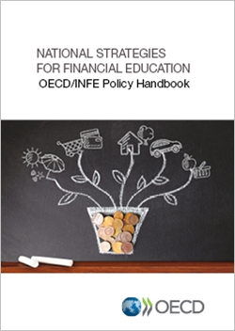
Some Sources for Financial Education
International organizations
OECD
AFI
WB
CGAP
Notes:
http://www.oecd.org/finance/financial-education/
https://www.oecd.org/daf/fin/financial-education/National-Strategies-Comparative-Tables.pdf

Slide 55
Questions?
Armenuhi Mkrtchyan
Head of Consumer Protection and Financial Education Centre,
Central Bank of Armenia
armenuhi.mkrtchyan@cba.am
www.cba.am – for Armenian legislation
www.abcfinance.am – financial education website

