Slide 1
Digital Finance –Building Trust in Digital Financial Services
Ivan James Ssettimba

Slide 2
Outline
Introduction
Mobile Money as DFS
Service Quality of DFS
Fair treatment of Customers
Quality and integrity of Agents

Slide 3
Digital Financial Services
What are Digital Financial Services?
Why promote Digital Financial Services?
Five minutes to think about these two questions and then discuss in plenary

Slide 4
Introduction
The broad range of financial services accessed and delivered through digital channels, including payments, credit, savings, remittances and insurance.
“digital channels” refer to the internet, mobile phones (both smart phones and digital feature phones), ATMs, POS terminals, NFC-enabled devices, chips, electronically enabled cards, biometric devices, tablets, and any other digital system.
DFS models usually employ agent networks to deliver financial services
Source: AFI Digital Financial Services Working Group

Slide 5
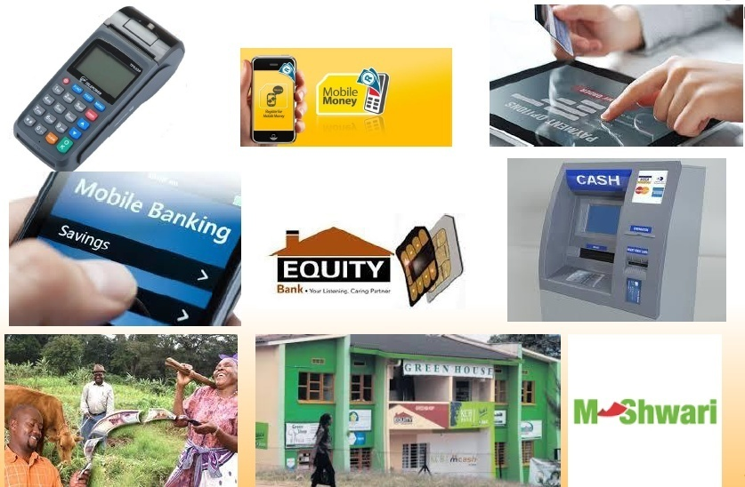
Introduction

Slide 6
Introduction
Why increased interest in DFS in past few years?
Facilitates financial inclusion through:
  Allowing for innovative delivery channels to increase access
  Minimizing cost of offering financial services
  Providing services at a cost people can afford
  Allowing for innovation around information based financial services
  Providing increased convenience and affordability of services to customers.

Slide 7
Introduction
Who needs digital financial services?

Slide 8
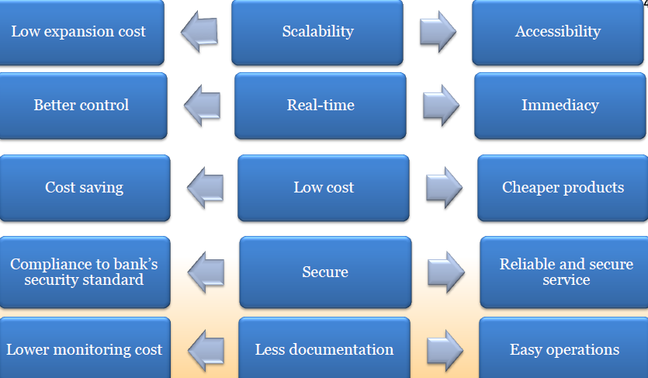
Introduction
Benefits of digital financial services?
Benefits to FSPs Function Benefits to Customers

Slide 9
Mobile Money as DFS
Mobile Money is one of the most profound DFS
A type of electronic money (E-Money) that is transferred electronically using mobile networks and SIM-enabled devices, primarily mobile phones.
The issuer of mobile money may, depending on local laws and the business model, be an MNO, a financial institution or another licensed third-party provider.
As shown in the preceding slides, uptake of MM has been enormous thus a need for customers to have a good understanding of MM-
Source : GSMA state of industry report on mobile money 2016

Slide 10
Mobile Money as DFS
Source: GSMA State of Industry Report 2017

Slide 11
Mobile Money as DFS
Source: GSMA State of Industry Report 2017

Slide 12
Mobile Money as DFS
Source: GSMA State of Industry Report 2017

Slide 13
Mobile Money as DFS
Source: GSMA State of Industry Report 2017

Slide 14
Mobile Money as DFS
Source: GSMA State of Industry Report 2017

Slide 15
Mobile Money as DFS
Source: GSMA State of Industry Report 2017

Slide 16
Service Quality of DFS
As uptake of DFS increases there is need to ensure protection of consumers;
  By empowering them to make informed financial decisions
  By enabling them exercise their rights and meet their obligations
  By ensuring they have access to adequate, timely and efficient redress for their complaints.
Consumer protection regulations tend to pursue the following broad objectives:
  to ensure that consumers have enough information to make informed financial decisions;
  ii) to prevent unfair practices by service providers; and
  iii) to ensure that consumers have access to recourse mechanisms to resolve disputes.

Slide 17
Service Quality of DFS
Objectives should be balanced i.e.
  not place onerous restrictions on the provision of the financial products and services and the channels used to deliver them.
Particularly important when the target population is low income and/or disadvantaged group,
  Vulnerable segments of the population, are usually first timers with formal financial services and have limited ability or power to protect themselves from unfair practices.
Regulators face a dilemma: protecting consumers without imposing high compliance costs on service providers.
  High costs can affect the ability of DFSP to make services accessible to this target population and negatively impact their business model.
To achieve the required balance there is need to
  clearly identify the risks and constraints consumers face when they register for DFS

Slide 18
Service Quality of DFS
  Identify challenges that may arise when they use MFS, such as those related to language, culture and general knowledge and attitudes about technology
Next, regulators should be aware of and understand all the factors that influence the conduct of DFSPs and to manage the risks and inherent costs involved
Key issue is whether the provision of financial services through mobile phones changes the risks consumers face with traditional channels.
DFS dramatically reduce the cost of delivering financial services and promote greater financial inclusion, by reaching new segments of the population and more geographical areas.
With lower delivery costs, providers are able to provide services to more customers, creating transaction volumes- thus increased profitability

Slide 19
Service Quality of DFS
With a broad target market that includes the unbanked, who may be using financial services for the first time,
Risks come from both the demand and supply side.
  Large proportion of target customers may not be literate in regard to DFS and may be technologically challenged
  Use of DFS introduces new operational and technical risks, such as new forms of fraud and inappropriate product design and system failures
The above two can lead to loss of trust and confidence by the consumers.
There is need for regulators to protect consumers of DFS, through identification of vulnerabilities at the various stages of consumption of DFS

Slide 20
Service Quality of DFS
Marketing stage: Consumer is informed about service availability
Vulnerability: Lack of consumer knowledge or understanding of the new service and DFSP. Lack of awareness or misperception about the nature/gravity of different risks of using the service (including the comparison to current informal options).
Threats: • Gap between a customer’s expectations and the services actually offered • Uncertainty about which party is ultimately responsible
Risks: • Potential for fraud • Errors in making decisions • Lack of trust, failure to adopt service
CP Initiatives : Create a requirement that DFSPs provide clear, adequate, accurate and complete information to consumers about the responsibility of the DFSP and “key facts” related to registration, transactions and product/service features

Slide 21
Service Quality of DFS
Registration stage: Client receives information about the service, fills out a registration form and selects a PIN
Vulnerability | Threats | Risks | CP Initiatives :
Insufficient agent training • Lack of client knowledge and awareness of risk • Inadequate data security platforms and processes | • Poor services • Lack of adequate information from agent • Weak security of selected PIN or storage of personal information in the mobile phone • Inadequate handling of customer data at agent’s premises (including both privacy and data security concerns) | • Reputational risk • Operational risk: identity theft or theft of authentication parameters, which can lead to a loss of funds | • Disclosure of information and operator support • Accessible, complete, clear, plain and understandable language • Client education and awareness programs • Consumer complaints and redress mechanism

Slide 22
Service Quality of DFS
Transaction stage: Customer performs cash-in/out transactions, payments and transfers
Vulnerability | Threats | Risks | CP Initiatives
• Low-income/ indigenous population with limited access to information or low levels of literacy/numeracy (e.g. Terms and Conditions) • Shared mobile phone usage within the family or community • Transactions facilitated by agents or others • Customer interface is overly complex and not intuitive | •Inaccurate/uninformed decisions • Potential for fraud | •Erroneous transactions •Vulnerability to fraud • Loss of trust | • Disclosure of information • Accessible information • Consumer education • Improvements in business processes that reduce the risks (e.g. contact/address book appears to facilitate transaction or the receiver’s name appears before the person confirms the transaction, to reduce transactions sent to an unintended third party)

Slide 23
Service Quality of DFS
Transaction stage: Customer performs cash-in/out transactions, payments and transfers
Vulnerability | Threats | Risks | CP Initiatives
Provision of DFS relies on
i. Client equipment with low security functionality and lack of end-to-end encryption ii. Client skill in following procedures and security measures | • Interception of traffic between mobile phone and point of service • Inaccurate transactions | • Identity theft, wrongful access, used to conduct transactions • Erroneous transactions • Loss of client funds | • Minimum security requirements for mobile phones • Product design and business process improvements • Appropriate risk management policies • Customer service support • Consumer complaints and redress mechanisms • Educational campaigns

Slide 24
Service Quality of DFS
Transaction stage: Customer performs cash-in/out transactions, payments and transfers
Vulnerability | Threats | Risks | CP Initiatives
Provision of DFS relies on
iii. Communication network | • Failures in the system, inability to complete transactions | • Reputational risk •Incomplete or delayed transactions •Possible loss of funds | • Customer support services Minimum standards for uptime • Require alpha/beta system tests • Redundancy and contingency plans • Ensuring real-time transaction services are in place and must be used

Slide 25
Service Quality of DFS
Transaction stage: Customer performs cash-in/out transactions, payments and transfers
Vulnerability | Threats |  | Risks | CP Initiatives
Provision of DFS relies on
iv. Agent network | • Fake agents • Agent misconduct and poor service • Lack of agent liquidity | • Potential for fraud • Perception that the service is unreliable |  | • DFSP liable for agent services and conduct • Agent training and oversight • Minimum requirements, proper signage, training and support for agent networks • Liquidity management/support • Disclosure of transaction limits • 24/7 operator support • Consumer complaints and redress mechanism

Slide 26
Service Quality of DFS
Acquisition, transaction or more complex value-added stages
Vulnerability | Threats | Risks | CP Initiatives
• Diverse DFSPs • New financial service providers as DFSPs | • Misuse of funds • DFSP insolvency • Inadequate management of fraud risks | • Fraud •Loss of client’s stored value funds • DFSP bankruptcy | • All DFSPs under supervision • Protection of funds and investment policies (i.e. trust agreements) • Both internal and external consumer complaint and redress mechanisms

Slide 27
Service Quality of DFS
Acquisition, transaction or more complex value-added stages
Vulnerability | Threats | Risks | CP Initiatives
• Personal and transaction information known to DFSP or agents | • Client privacy Issues | • Reputational risk •Fraud and/or identity theft | • Data privacy and client secrecy regulations • Internal and external consumer complaint and redress mechanisms

Slide 28
Service Quality of DFS
Acquisition, transaction or more complex value-added stages
Vulnerability | Threats | Risks | CP Initiatives
• Outsourcing part or all DFS to third parties | • Customers unclear about which party is responsible and where, how and whom to address complaints • Complaint is not handled adequately | • Reputational risk | • Clear customer communication re: who the DFSP is and who is responsible for each of the services provided • 24/7 customer support • Internal and external consumer complaint and redress mechanisms (and standards to ensure they are adequate and consistent) and reporting requirements to allow the supervisor to monitor potential trouble spots or poorly performing DFSPs in the market

Slide 29
Fair treatment of Customers
Responsibilities of Regulators
Put in place a proportionate risk-based regulatory framework for consumer which also allows for innovation and aims to achieve the overall objective of financial inclusion;
Approve DFSPs to operate under clear rules to protect consumer funds from misappropriation by the DFSP, insolvency, fraud or any operational risk;
Provide a level playing field that promotes competition to boost efficiency and increase consumer choice;
Require appropriate and accurate standards for disclosure of information;

Slide 30
Fair treatment of Customers
Responsibilities of Regulators
Put in place simplified consumer protection rules for low-value transactions under the guiding principle of proportionate risk-based policies;
Require DFSPs to be responsible for all their services whether provided directly to the consumer through a mobile network carrier or through agents;

Slide 31
Fair treatment of Customers
Responsibilities of DFSPs
Carry out market research (on capabilities, processes and security levels) to design products that suit the needs of the customers
Put in place processes to educate consumers about their rights, duties and responsibilities in the use of DFS,
  consumer education and risk awareness programs that inform them of the consequences of not being prudent and responsible when accessing the service (providing clear examples of acts of negligence or misconduct);
Comply with regulations that aim to ensure services are provided in a safe, reliable and transparent way;
Manage operational risk by having appropriate operational manuals, internal control procedures and contingency plans

Slide 32
Fair treatment of Customers
Responsibilities of DFSPs
Ensure they have appropriate contracting manuals and an operational manual that explains how to carefully screen, train and monitor agents and/or outsourced agent network operators; and
Have a fair and effective internal complaints/redress system.
Have in place a strong customer support service

Slide 33
Quality and integrity of Agents
Agents are typically used in the provision of DFS, and are often the first point of contact with consumers. They open accounts and conduct transactions on behalf of SP.
SP are responsible for the actions of their authorized agents and must provide adequate oversight, observe a minimum set of requirements (established by regulators) to select an agent, provide appropriate training to agents and ensure that agents act in the best interest of consumers.
In addition the SP should ensure that:
  agents can uniquely and clearly be identified by consumers by using appropriate signage and have clear and established customer hotline numbers in place.
  agents maintain consumer confidentiality by having effective data and privacy control standards/mechanisms.
  consumers are provided with accurate and full disclosure of all product services, features and rates at all agent locations.
  agents have sufficient liquidity to be able to serve their customers

Slide 34
Quality and integrity of Agents
Agent Misconduct towards SPs and Customers
Unauthorized access to customer PINs: agents gain access to customer PIN numbers and conduct fraudulent transactions.
Imposition of unauthorized customer charges: agents charge customers fees for transactions above and beyond the list price and fraudulently keep the fees instead of remitting to the provider.
Direct deposits: agents directly deposit funds from a customer into another customer’s account instead of cashing in, and then send a transfer funds request in order to avoid the fee.
Registration of customers with fake details: agents sign up customers that do not provide accurate KYC information.
Registration of non-existent customers: agents sign up ghost-accounts in order to receive the registration commission.

Slide 35
Quality and integrity of Agents
Agent Risk Management
Agent Density: right number of agents are deployed to serve customers, not too few and not too many. Market research on customer population and transaction activity
Liquidity: require cash on hand and e-value to manage customer’s transaction requests for cash in and cash out on a day-to-day basis. Use liquidity managers and credit facilities
Theft of Cash Float: excessive cash deposits expose agents to potential theft. Liquidity managers should offer pick-up and drop-off services
Teller Errors: key stroke errors in entering transactions or counting errors in cash management that result in losses. Constant training of agents
Agent Selection: policies include minimum suitability criteria (based on regulatory requirements and the provider’s assessment of required capacity)

Slide 36
Quality and integrity of Agents
Agent Risk Management
Branding and Marketing: standardised branding and marketing materials, for consistency in customer experience and confidence in the service.

Slide 37
Conclusion
DFS have the potential to increase financial inclusion in the MEFMI region
Central Banks in the MEFMI region should;
  Ensure that certain minimum requirements and standards are met and that all SPs provide appropriate consumer education and information.
  Play a more proactive role in financial education programs geared towards people at the base of the economic pyramid to help improve the understanding, opportunities and risks associated with the financial system and its products and services.
The quality of services rendered by DFS providers will have an impact on the uptake of DFS
There is need to empower consumers of DFS to ensure that they clearly understand the services they are consuming.

Slide 38
References
GSMA State of Industry Report 2016
mfswg_guideline_note_7_consumer_protection_in_mfs

Slide 39
THANK YOU

