Slide 1
Digital Tools for Financial Literacy
Ivan James Ssettimba

Slide 2
Digital Tools for Financial Literacy
Technological innovations are changing our lives faster than ever before- websites, mobile phones apps, social media.
In 2015, 83% of households in Africa had access to the internet and 76% of those aged between 16 and 74 were regular users of the internet.
57% of individuals used a mobile device to connect to the internet in 2015, up from just 36% in 2012.
Key benefit of improved technological resources and tools is the potential to reach a wider section of the public, which can lead to higher levels of financial inclusion in the population as a whole.
Technology based tools can contribute to raising financial literacy levels and can help individuals to make more informed financial decisions.

Slide 3
Digital Tools for Financial Literacy
These tools assist in addressing barriers to financial literacy, including
making it faster and more convenient to access information and obtain more in-depth advice and guidance on managing finances.
The tools are interactive, easy-to-use and online. They allow citizens to access information relevant to their individual situations.
Technology also provides a more interactive and engaging means of involving children from an early age, both within the classroom as part of a formal school programme and more generally in the form of games and quizzes aimed at students.

Slide 4
Digital Tools for Financial Literacy
Our relationship with money is increasingly digital. Digital tools are revolutionizing our relationship with money — from digital banking to mobile payments and beyond.
Digital tools are becoming an educational platform. They promote smarter, more deliberate approach to money management, enabling users to apply financial education in real life:
Mobile and online banking helps users track financial goals, assess financial health, or receive alerts when problems might be arising.
Digital money management tools help users apply budgeting principles and stick to them by providing up-to-the-minute details on spending goals and activity.
Unlike most users, digital money management tools don’t get distracted or make miscalculations.

Slide 5
Digital Tools for Financial Literacy
Better, not more, information for consumers
To make informed financial decisions, consumers need to:
Be financially literate and to
Have access to information about the products and services available to them.
High-quality financial literacy and product information are essential and complementary, and it is important that regulators and policymakers get both aspects right.
Too much information tends to confuse consumers and distracts them from paying attention, thus target should be to provide high quality, relevant information.

Slide 6
Digital Tools for Financial Literacy
Organisation for Economic Co-operation and Development (OECD)
The OECD’s “Principles and Good Practices for Financial Education and Awareness” recommends that financial education starts as early in life as possible and that it be taught in schools.
It describes financial education as a long-term process that —if built into curricula from an early age — will allow children to acquire the knowledge and skills needed to manage finances better.

Slide 7
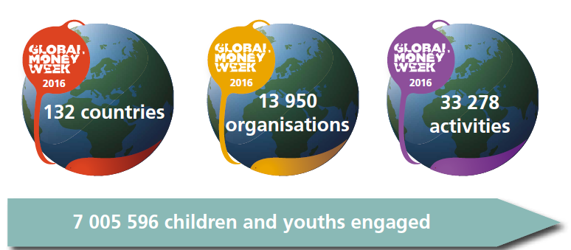
Digital Tools for Financial Literacy
Global Money Week
An annual event initiated by Child & Youth Finance International (CYFI), with local and regional events and activities
aims at inspiring children and youth to learn about money, saving, creating livelihoods, gaining employment and becoming an entrepreneur.
Held in March each year, it sees a range of events, activities, projects and competitions taking place in over 130 countries worldwide, aimed at creating awareness, challenging out-of-date financial policies and giving young people the tools and inspiration they need to shape their own future.

Slide 8
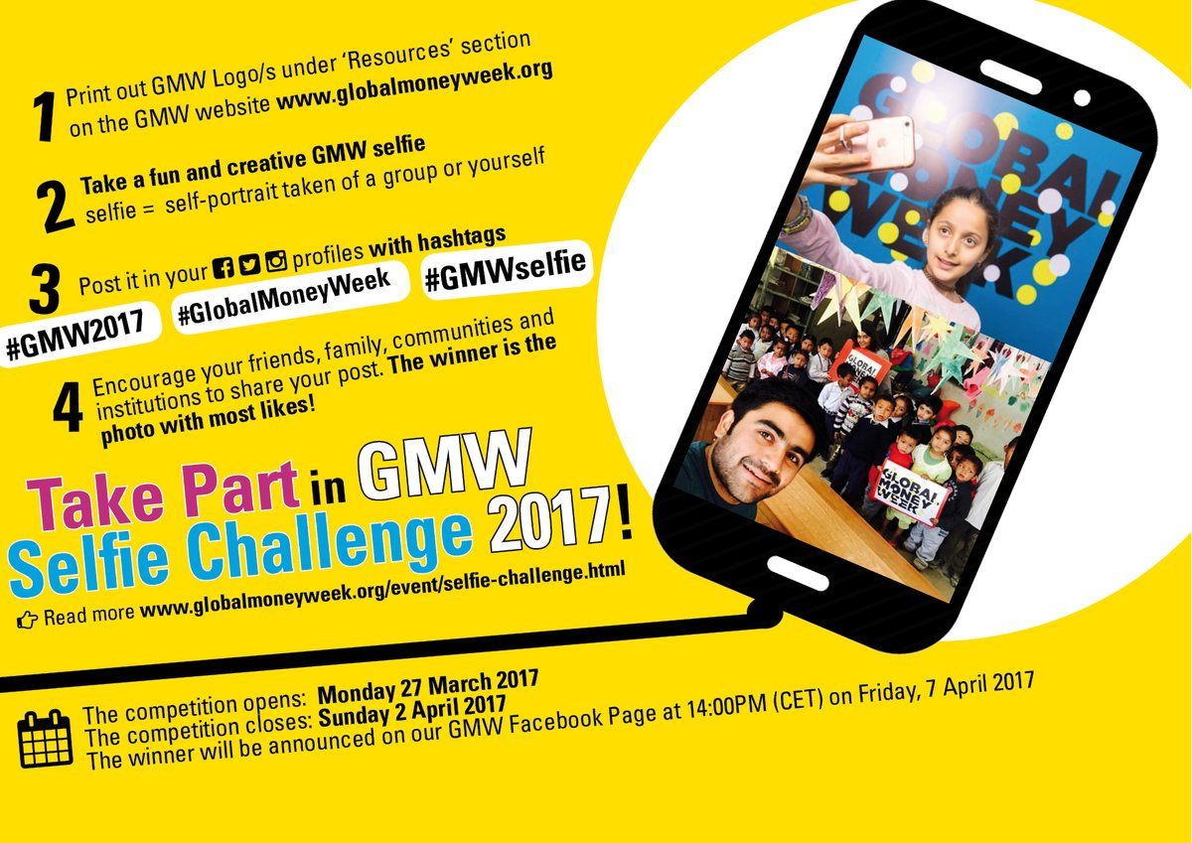
Digital Tools for Financial Literacy
Events in the Global Money Week
Selfie Challenge: competition to connect with other young people, individuals and organizations across the world in sharing their amazing money awareness activities and events. Photos are uploaded on social media such as facebook, whatsapp, twitter and YouTube

Slide 9
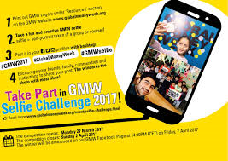
Digital Tools for Financial Literacy
Events in the Global Money Week
Video Challenge: video showing what you are doing to celebrate GMW2017! Whether you create a vlog of your Week’s celebrations, host an interview with a representative from a local institution or capture money awareness games and activities, videos are a great way to show how GMW is being celebrated in your community or country.

Slide 10
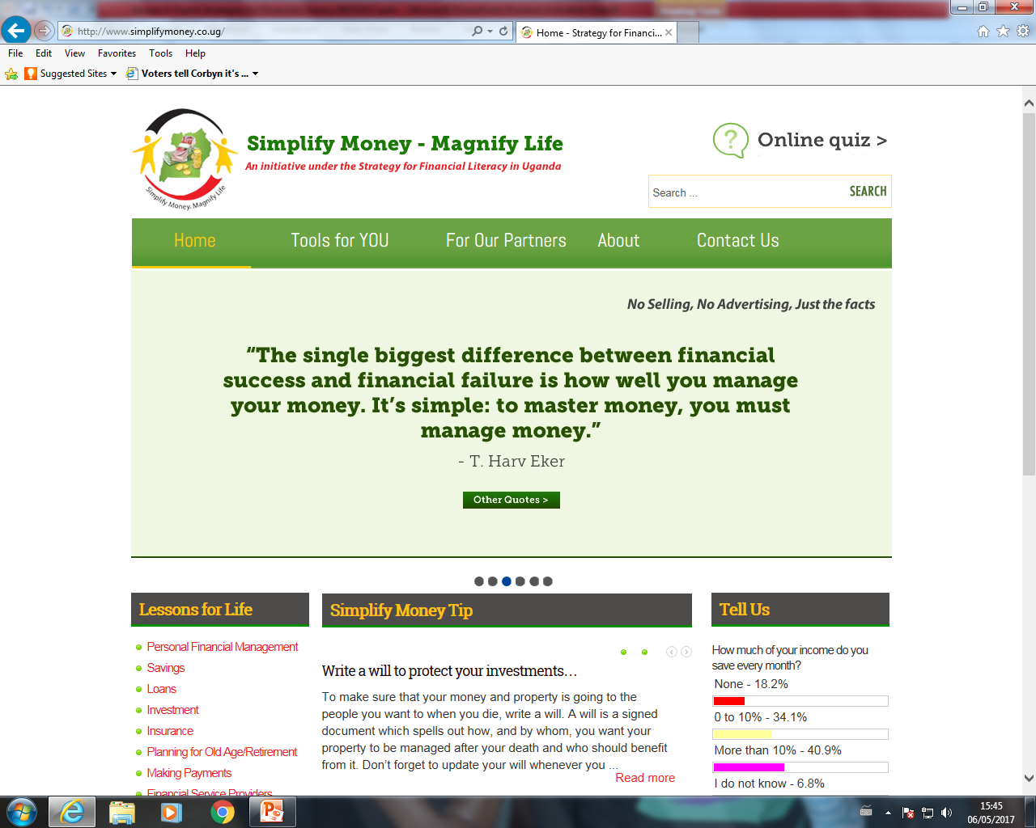
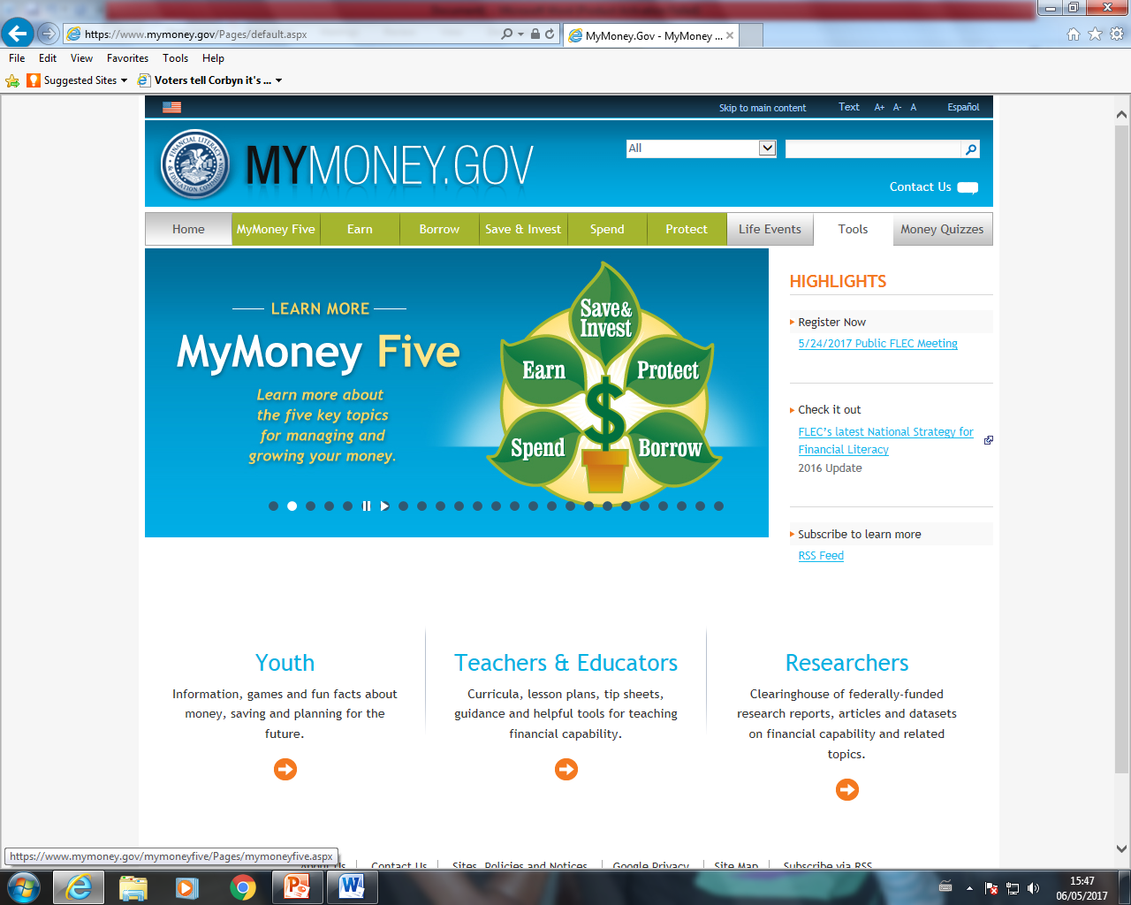
Digital Tools for Financial Literacy
Website: websites with information on financial literacy, with links to various resources such as reports, other tools; calculators, budgeting worksheets planning checklist. Does your Central Bank have a dedicated website to financial literacy/education?
http://www.simplifymoney.co.ug/
www.mymoney.gov

Slide 11
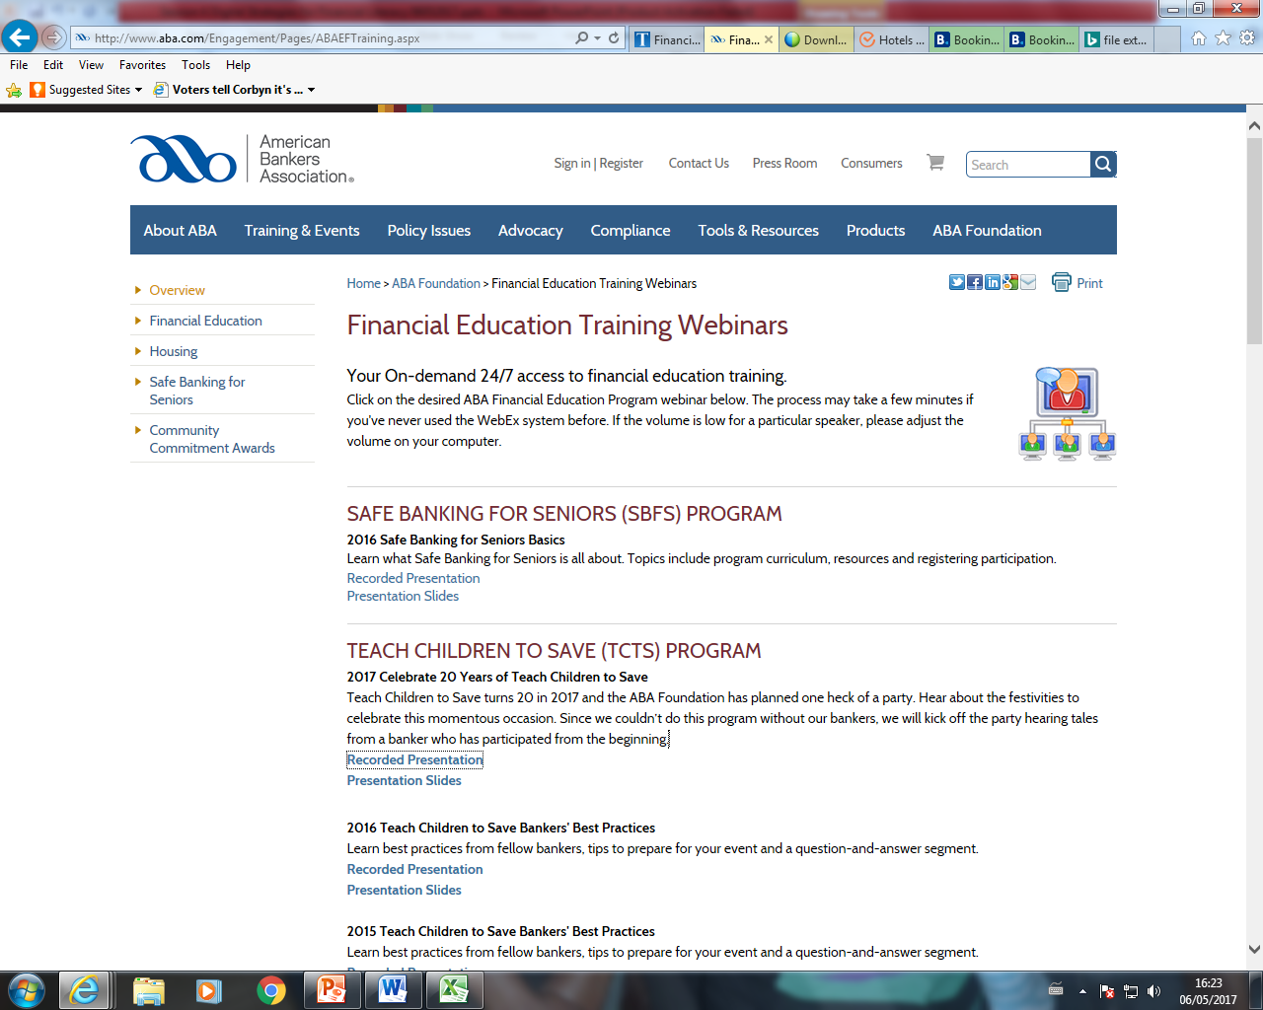
Digital Tools for Financial Literacy
Webinar (Web based seminars): is a presentation, lecture, workshop or seminar that is transmitted over the Web using video conferencing software. (WebEx)
Financial education training webinar- American Bankers Association; http://www.aba.com/Engagement/Pages/ABAEFTraining.aspx

Slide 12
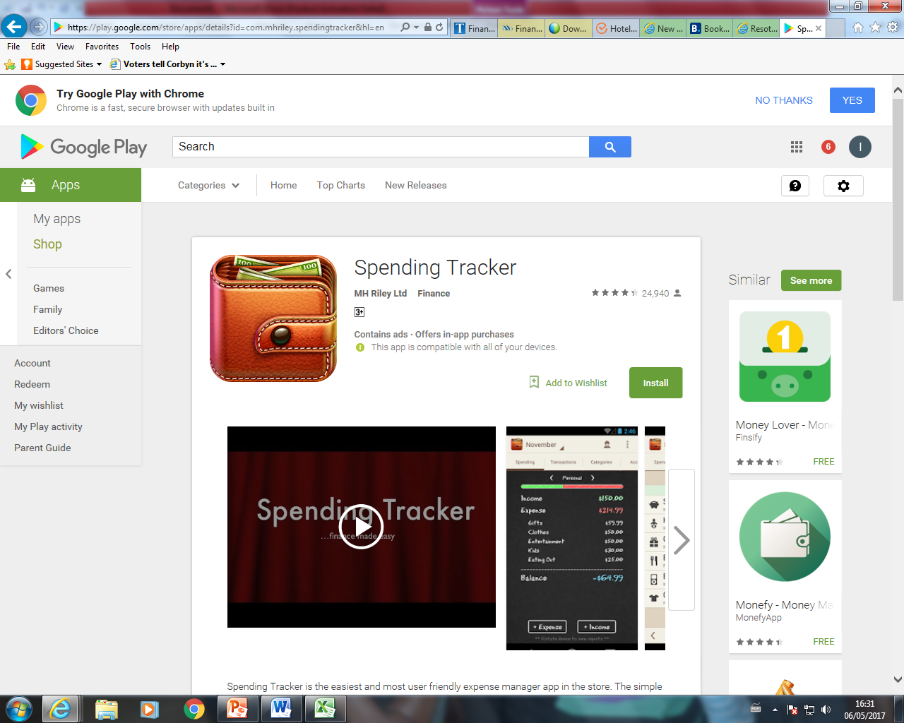
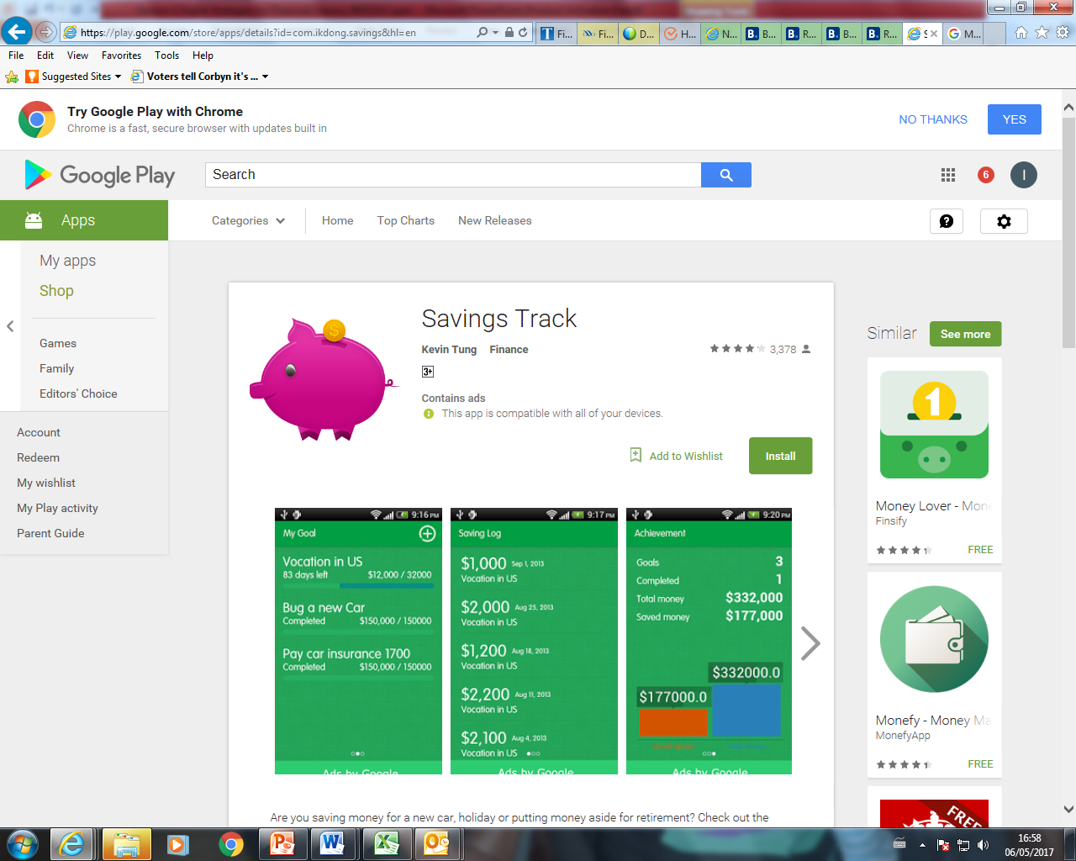
Digital Tools for Financial Literacy
Mobile applications: Applications that can be downloaded onto mobile devices to be used on the go. Apps can be customized to the local situation. Developed apps can be uploaded downloaded to play store or itunes, from where they can be downloaded.
Spending Tracker- Track your expenses, stick to a budget, save money
Savings Track- a perfect tool for keeping track of your savings and meeting your savings goals

Slide 13
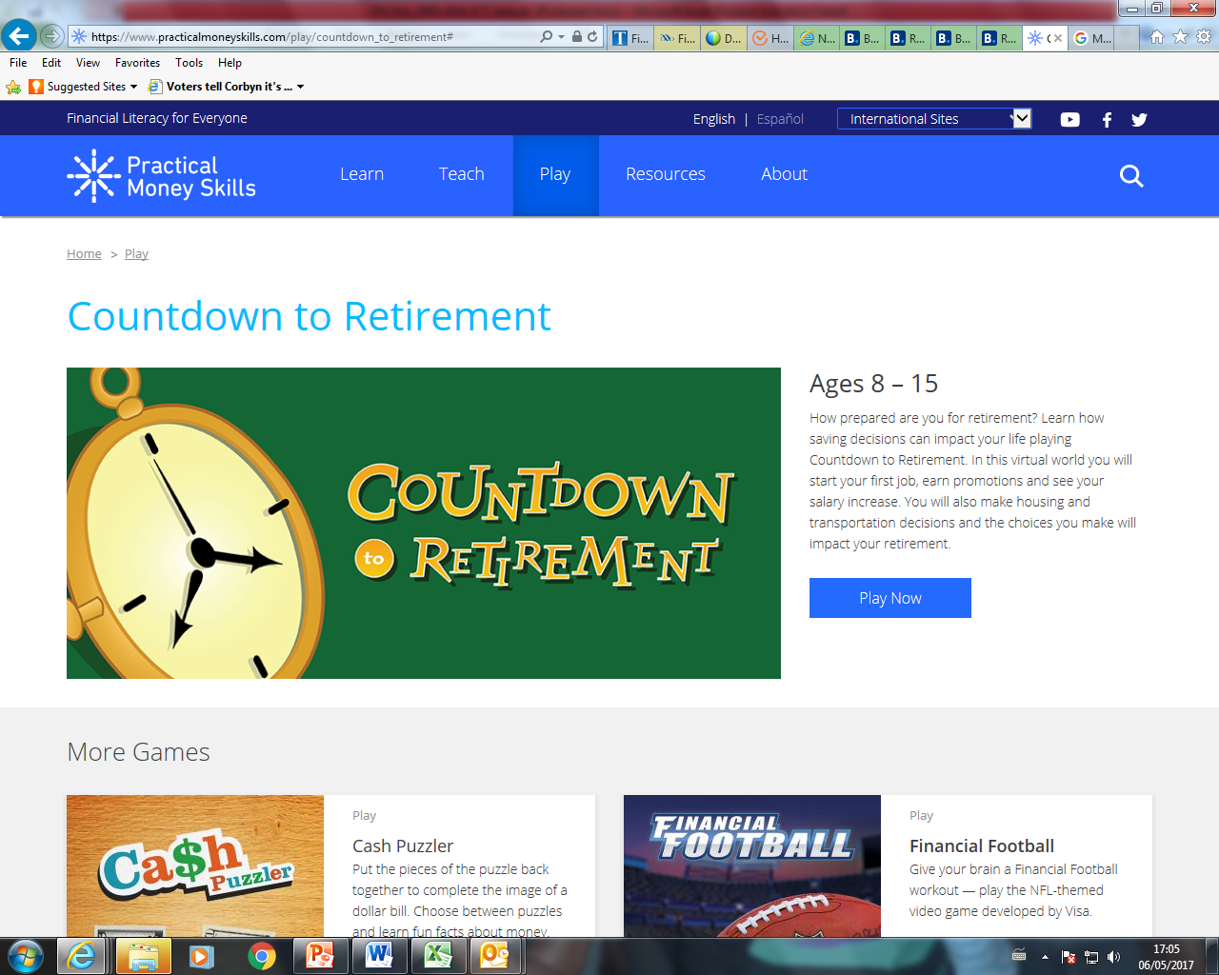
Digital Tools for Financial Literacy
Games: these provides an opportunity for players to improve on their financial capability in an informative and fun way.
https://www.practicalmoneyskills.com/play/countdown_to_retirement

Slide 14
Digital Tools for Financial Literacy
Social media: these facilitate the creation and sharing of information via virtual communities and networks.
Social media platforms all consumers to receive education in an easily digestible manner directly from experts.
Discussions on these platforms address timely and relevant topics.
For those that allow live streaming on mobile devices, the public is able to ask questions in real-time where ever they may be, when they need.
Social media presents a tremendous opportunity to reach a whole new generation in a convenient way.

Slide 15
Digital Tools for Financial Literacy
Entertainment media- television and Radio: offers not only broader outreach since nearly every household has a TV or radio, but also a captive audience. Furth more, as emotional connections are made between the show and its audience, the program provides a potentially powerful platform for communicating messages and influencing behavior.

Slide 16
Digital Tools for Financial Literacy
South African soap opera “Scandal”
Worlbank carried out a study to evaluate the economic impact of financial education messages on debt management delivered through a popular television soap opera in South Africa.
The study used a symmetric encouragement design to compare outcomes of individuals who were randomly assigned to watch a soap opera with financial messages, “Scandal!” to those of individuals who were invited to watch a similar soap opera without financial messages, “Muvhango.” Both shows overlapped in evening primetime and had similar past viewership profiles.
The financial storyline spanned two months and featured one of the leading characters of the show borrowing excessively and irresponsibly through hire-purchase, gambling, and ending up in financial distress; and eventually seeking help to find her way out.

Slide 17
Digital Tools for Financial Literacy
Two intermediate and one final follow-up surveys were conducted as part of the study.
The analysis found that individuals assigned to watch Scandal had significantly higher financial knowledge of the issues highlighted in the soap opera storyline, in particular messages delivered by the leading character.
On behavior, Scandal viewers were almost twice more likely to borrow from formal sources, less likely to engage in gambling, and less prone to enter hire purchase agreements.

Slide 18
Digital Tools for Financial Literacy
Financial Education via Television Comedy*
Another study by Monash University showed that television may be able to deliver rudimentary financial literacy in a cost effective manner.
In a controlled experiment, Cambodian garment factory workers were randomly allocated into one of three treatments: no video (baseline), slideshow, and comedy TV show.
After the intervention the participants were requested to answer a set of questions on financial knowledge and attitudes to examine whether individuals were able to internalize the information that was provided.
The results showed that participants randomly assigned to the comedy show were significantly more likely to report that they are interested in obtaining more information on savings account and were also significantly more likely to open a savings account in the next 6 months. This method of delivery may prove effective particularly for disadvantaged sections of the population.

Slide 19
Digital Tools for Financial Literacy
Financial Education through TV and Radio
The Bank of Mozambique has launched a TV drama on financial education. The cast of the show is drawn from within staff of the central bank,
The bank has an arrangement with the national broadcaster to air the show twice every month.
There is also a radio talk show every week, highlighting issues to do with financial literacy.
In Uganda drama skits have been developed and translated into several local languages and are aired on various regional radio stations.

Slide 20
Conclusion
Digital tools provide an effective and efficient way to deliver financial literacy/education programs for those segments of the population that has embraced technology.
However there is need to be mindful of the challenges that come with these tools, such as data privacy and exclusion for those who are not digitally literate.

Slide 21
THANK YOU

